Slide 1


Ontario Universities Fair
Largest North American undergraduate recruitment fair
UG had approximately 180 staff, faculty and students participate
2022 OUF was shortened to just two days (previously 3 days)
Strong interest in Computing and Engineering
Computing Volunteers
Rozita Dara – Faculty, Outreach
Purvi Patel – Recruitment Officer
Shaiza Hashmi – 4th Year Computer Science student
Rithik Choudhary – 4th Year Software Engineering student

Slide 2
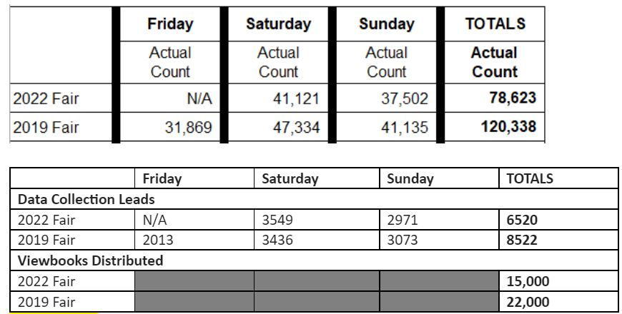
OUF DATA
Refers to attendee numbers
Refers to lead acquisition and material distribution

Slide 3
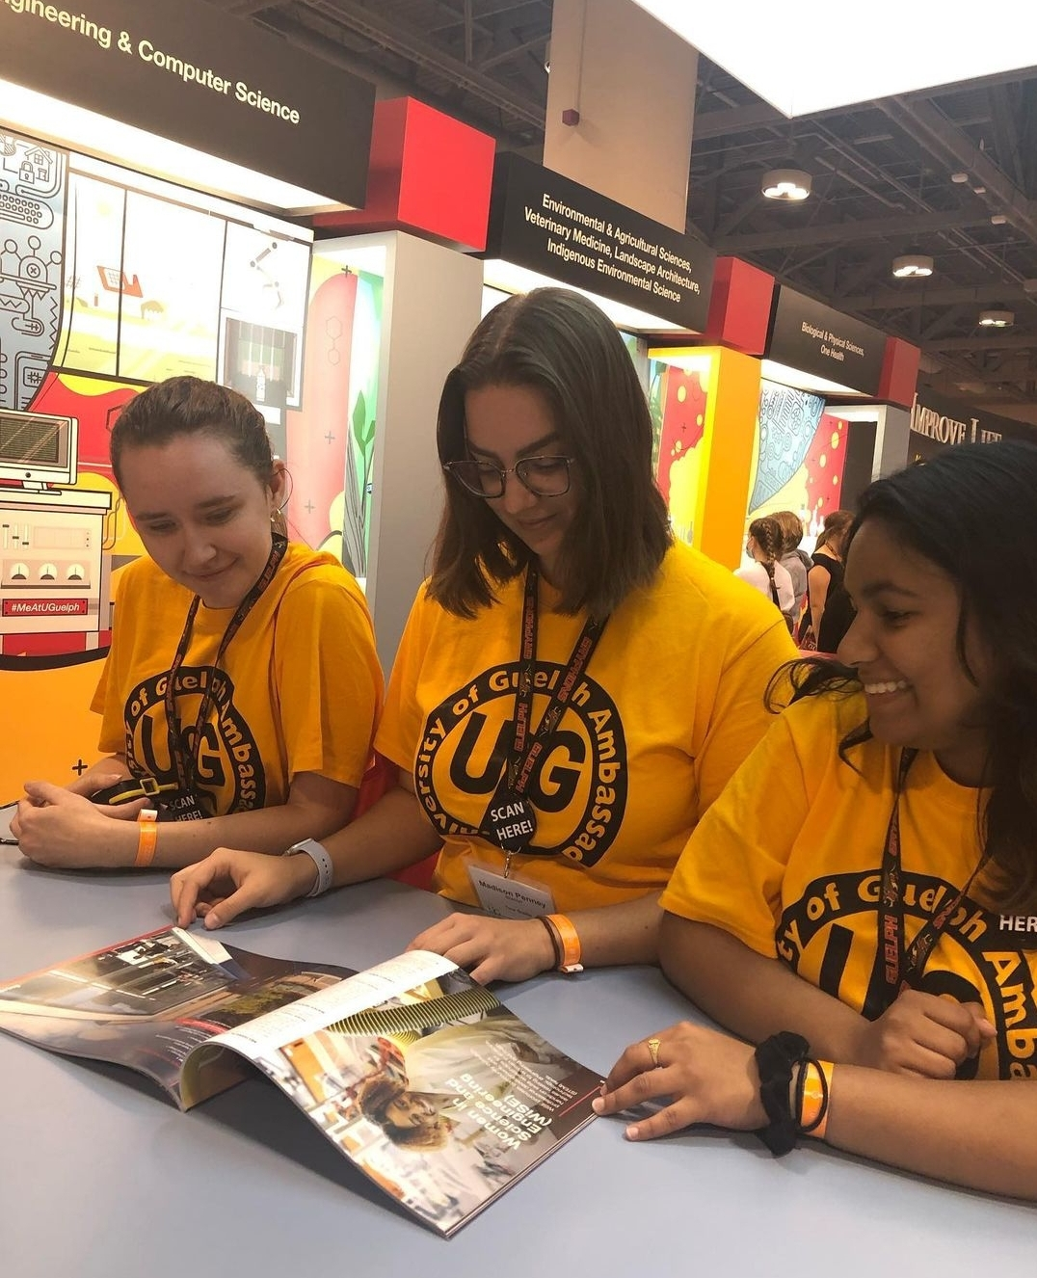
Questions, Factors
Admission related e.g. pre-requisite high school courses, what is the estimated cut off, coop, etc.
What is the difference between BENG and BCOMP computing majors?
More women approached us than anticipated
Our estimated cut off ranges (85%-90%)compared to some other schools are published lower – outcome?
Virtual OUF October 11– Purvi attended, about 200 guests and minimal questions overall

Slide 4
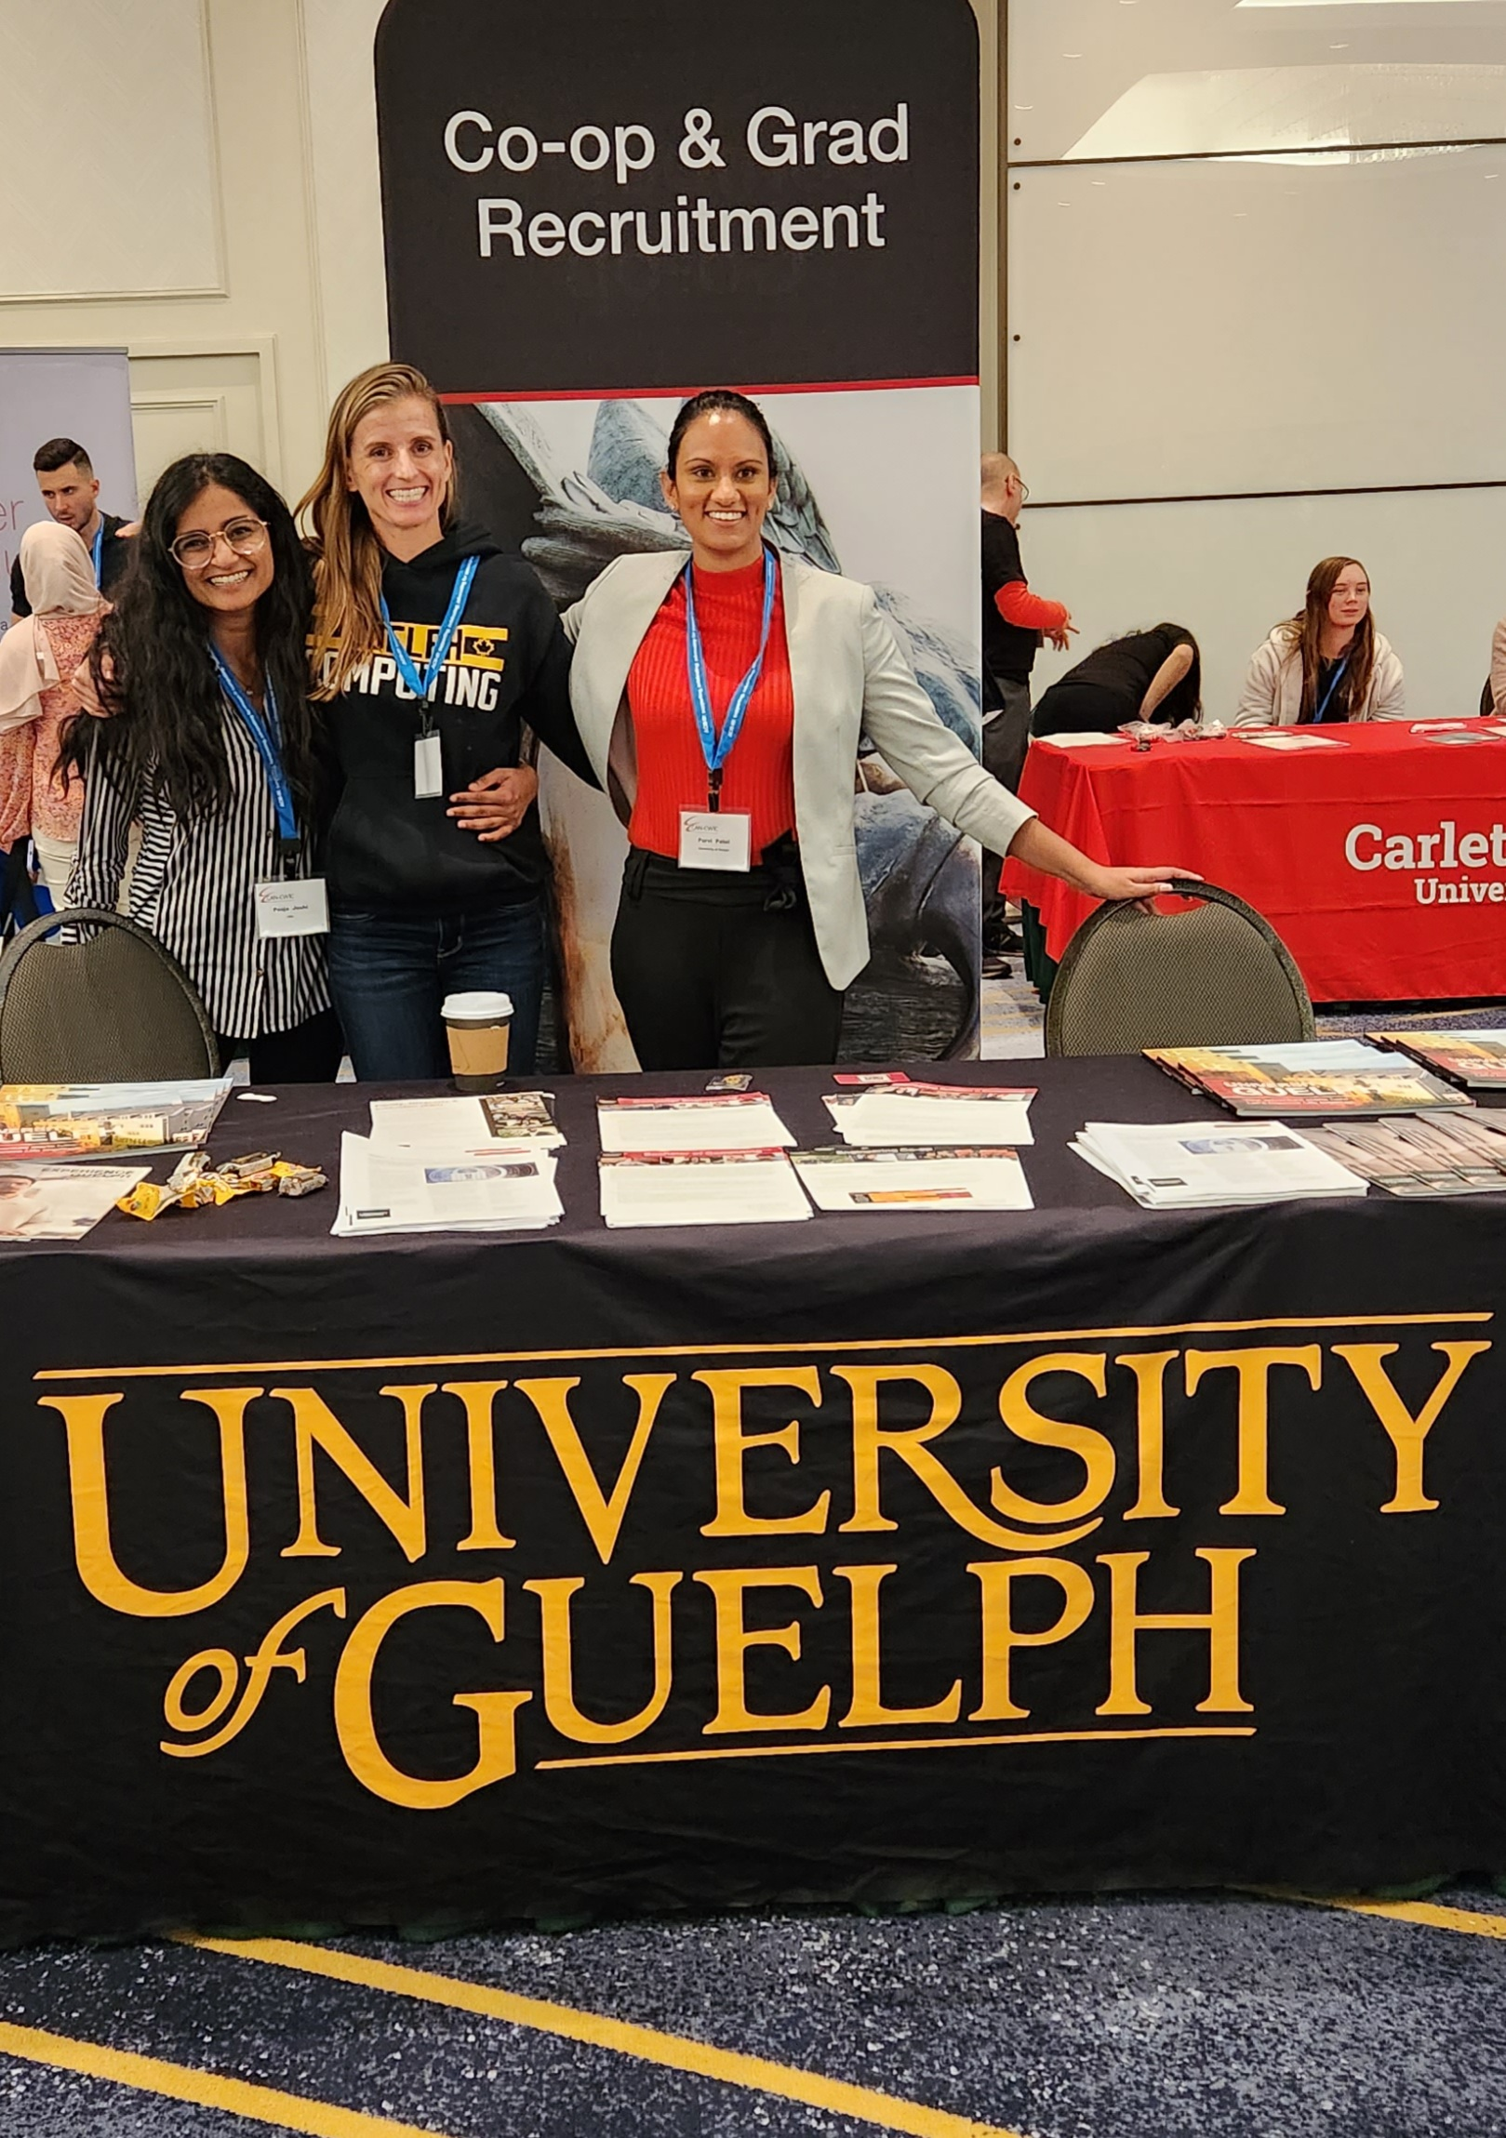
CAN-CWIC
Approximately 750 guests (67% undergrad)
28 UofG students attended (majority SoCS students (undergrad, grad, and MCTI students) and a few SEng students)
5 faculty and staff (SoCS, CEPS, and co-op coordinators)
4 parallel sessions (on Saturday), job fair & grad recruitment, keynotes
SoCS Co-op coordinators Laura Gatto and Kate McRoberts session 'Tips and Tools to land the Co-op or Internship You Want' – good interest and feedback

Slide 5
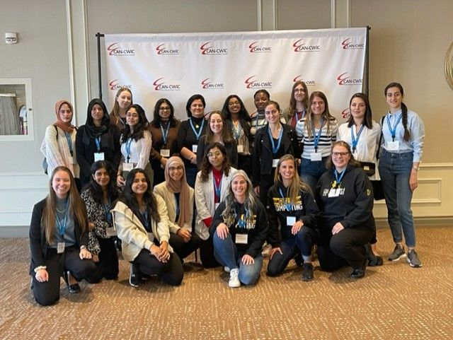
CAN-CWIC [cont'd]
Positive interest from undergraduate students in MCTI – popular due to 1 year duration (15 brochures)
Mentoring circles were organized for junior faculty members, PDFs and PhD students – Stacey and Rozita
Faculty sessions – Stacey and Rozita
Panel - Invisible workload for women: When to say yes, when to say no, when to suggest someone else - Stacey
  Panel - Hiring for diversity and post-hire support

