Slide 1
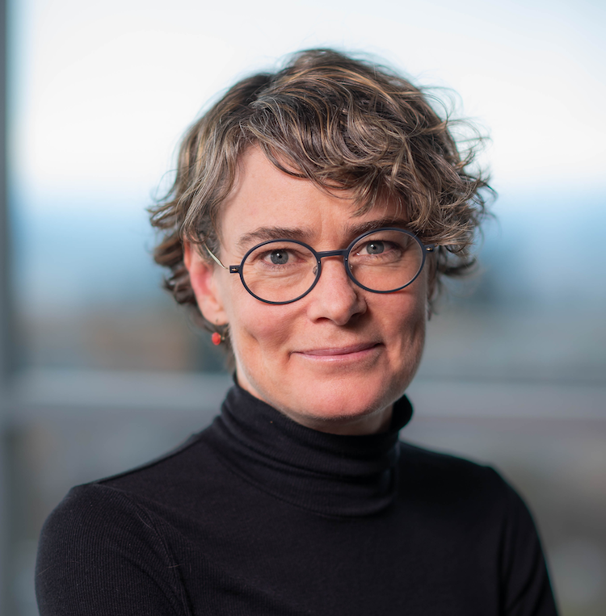

Tremaine Visiting Speaker
Series for Women
in Science
Dr. Joanna McGrenere
October 15-17, 2024

Slide 2
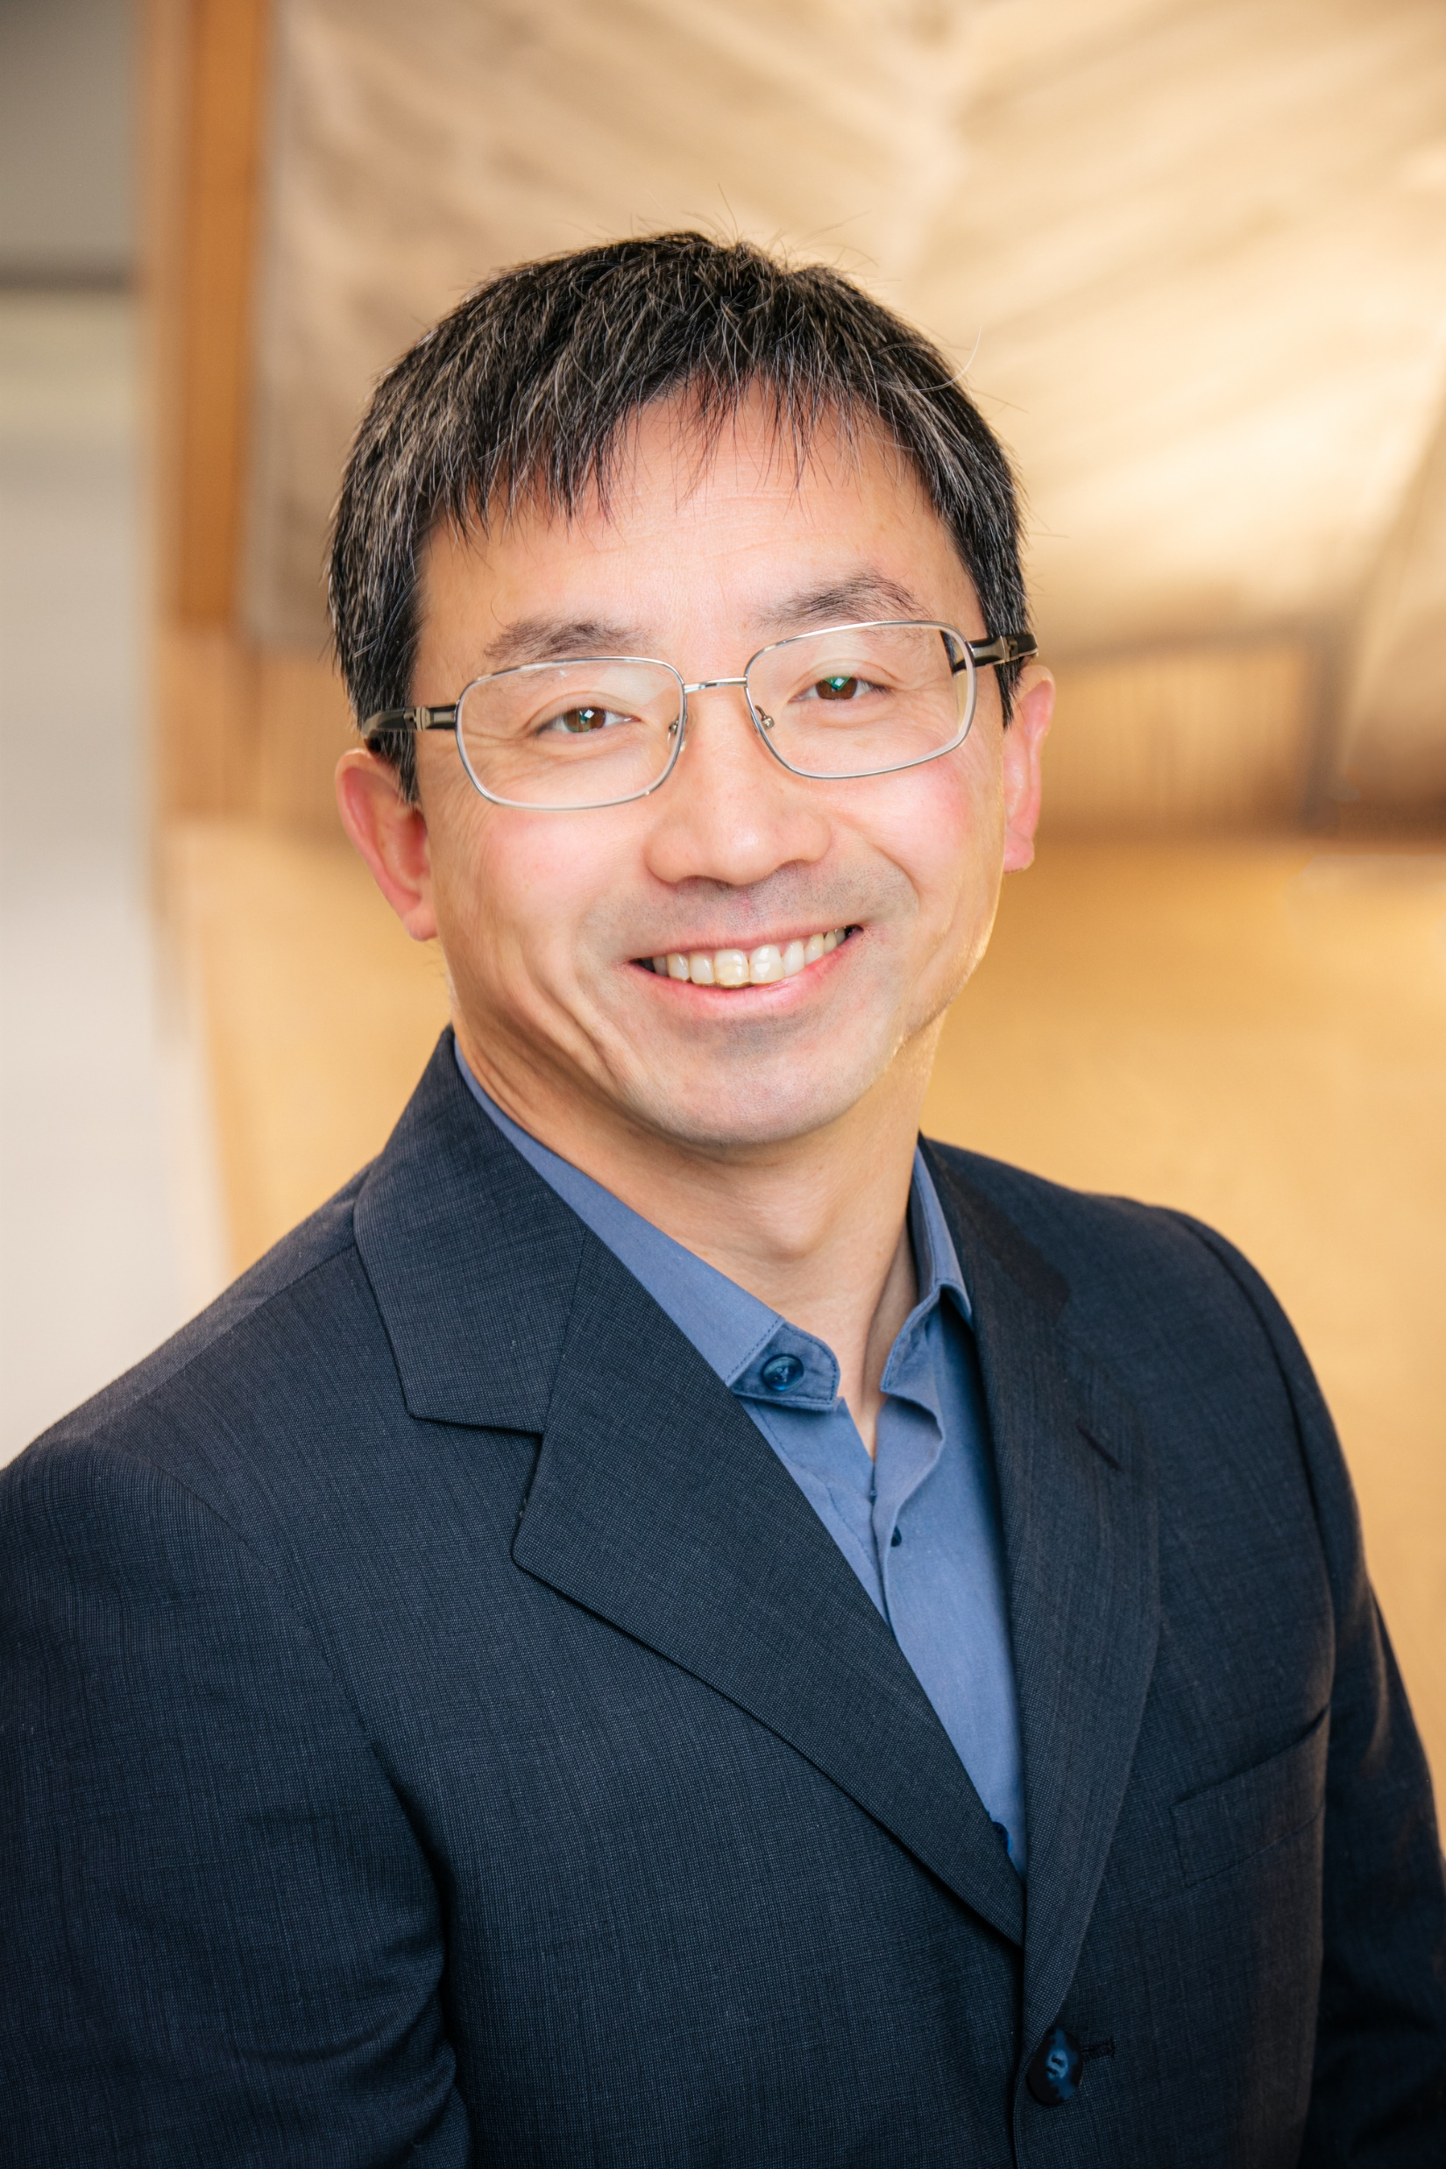
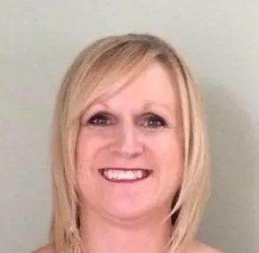
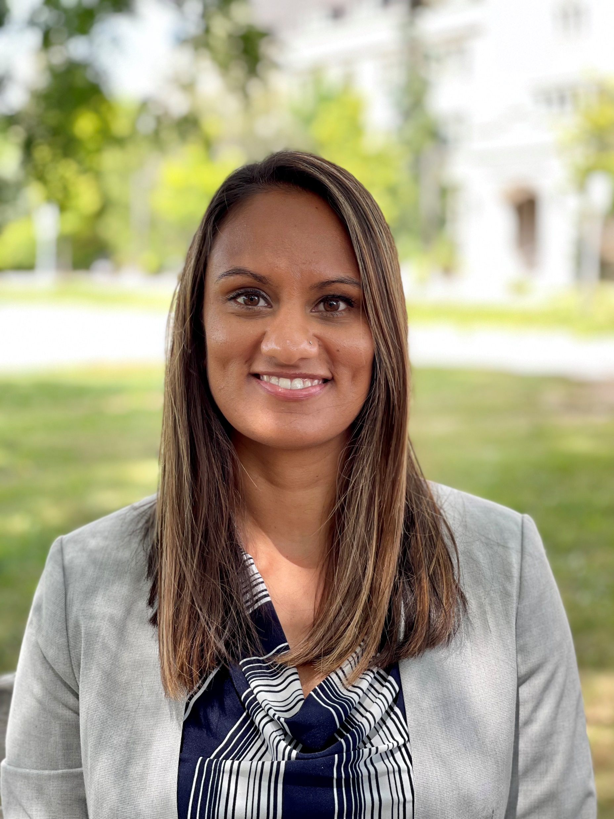
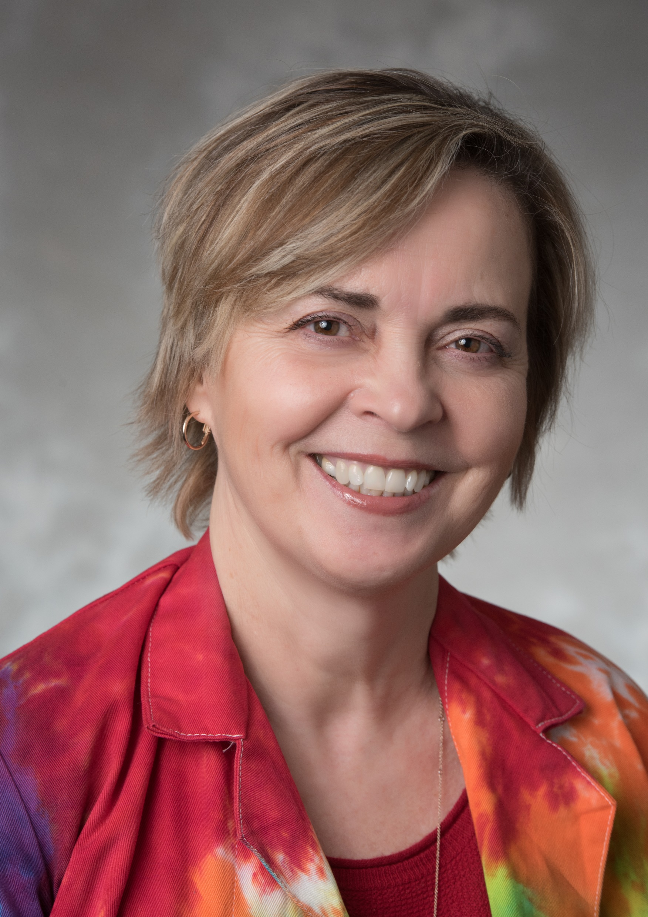
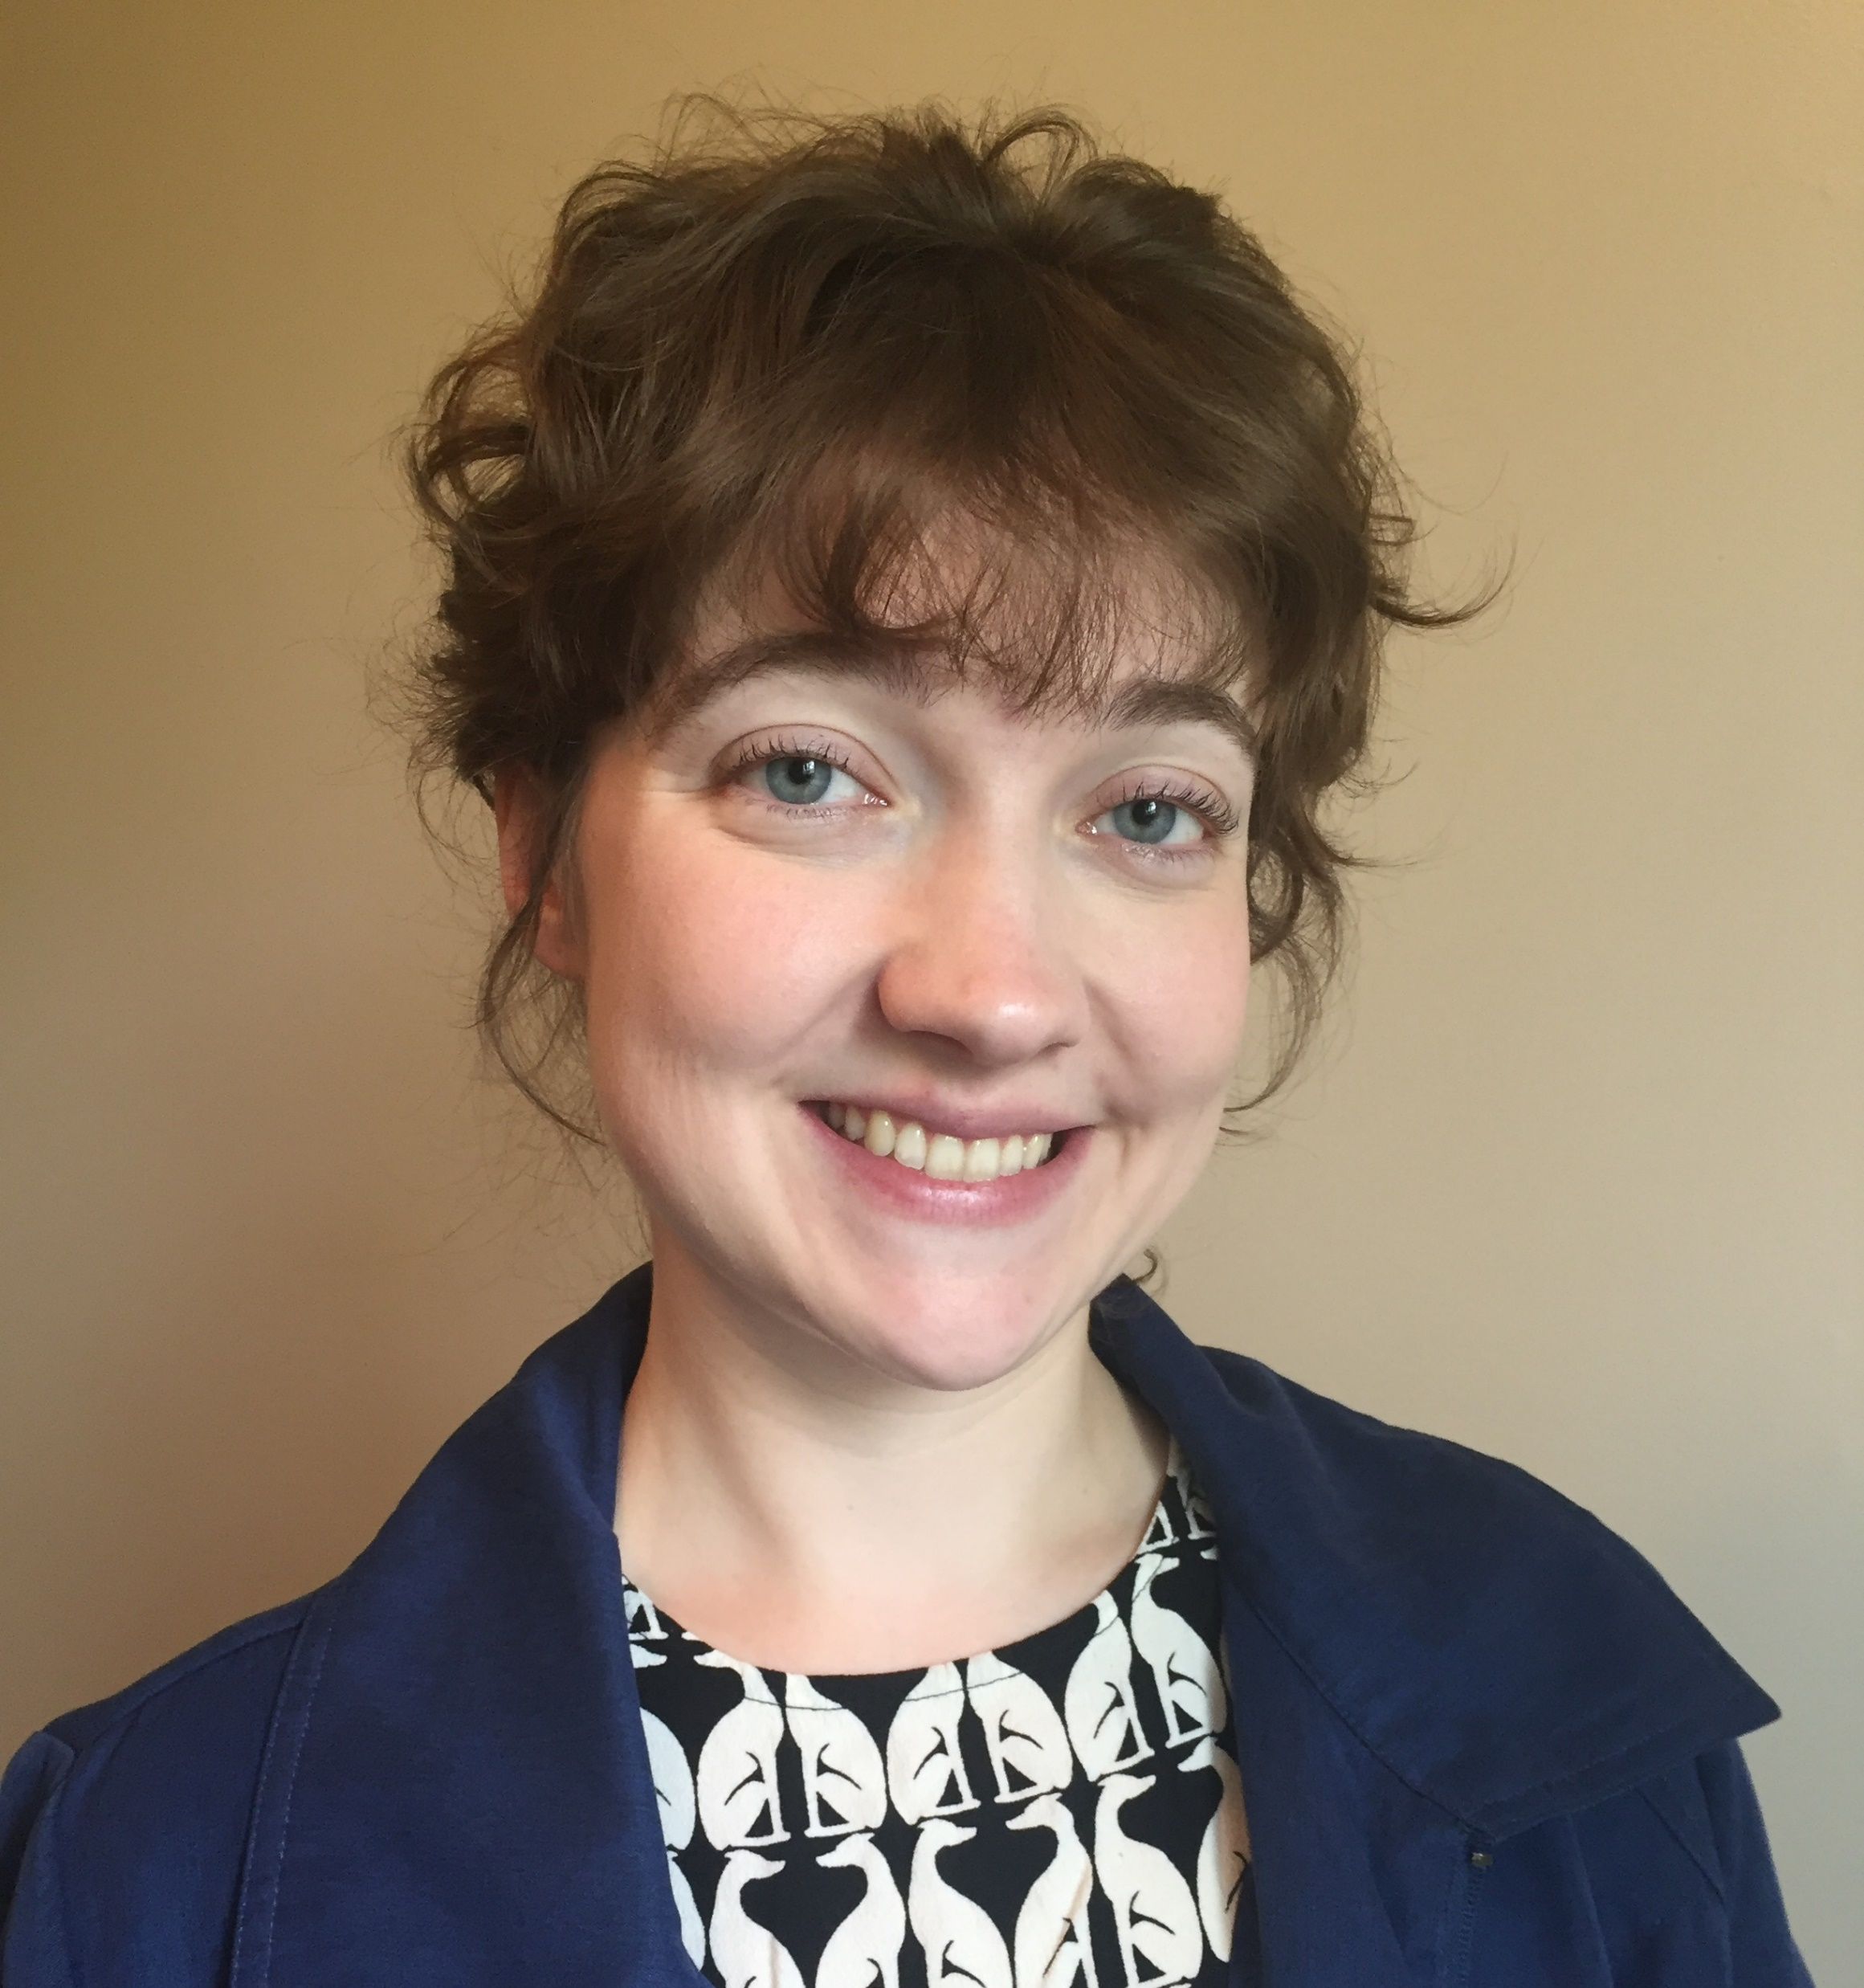
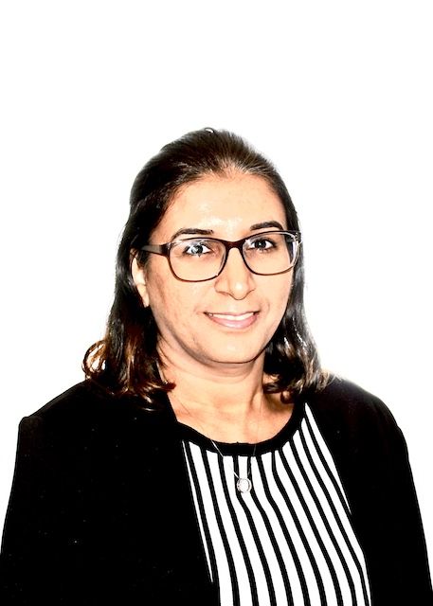
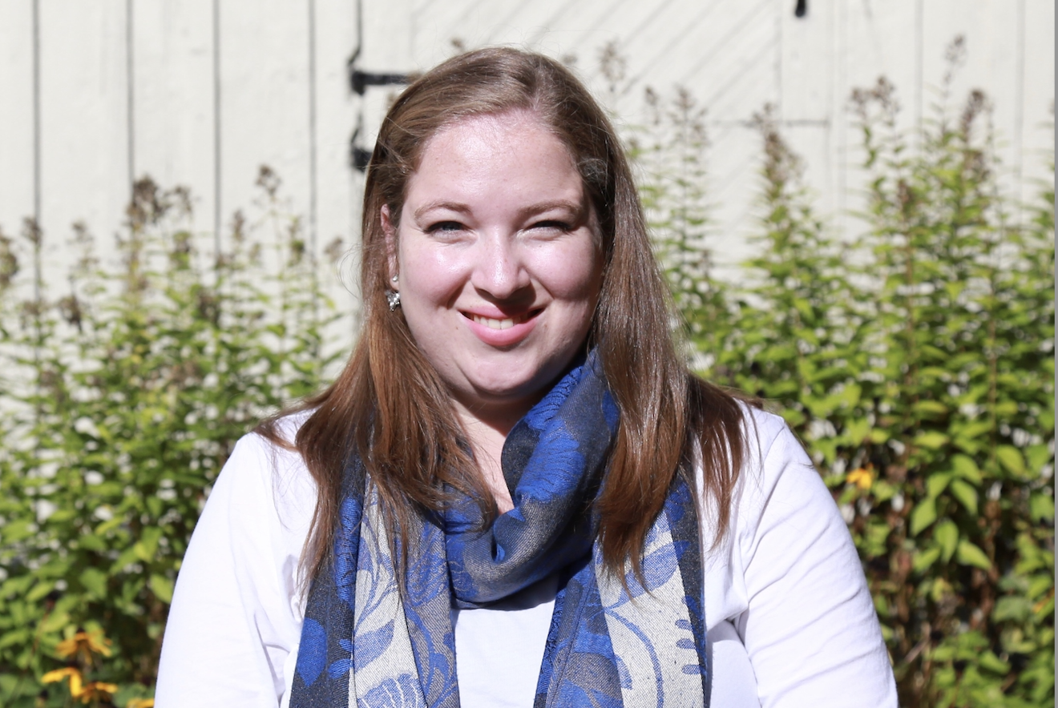
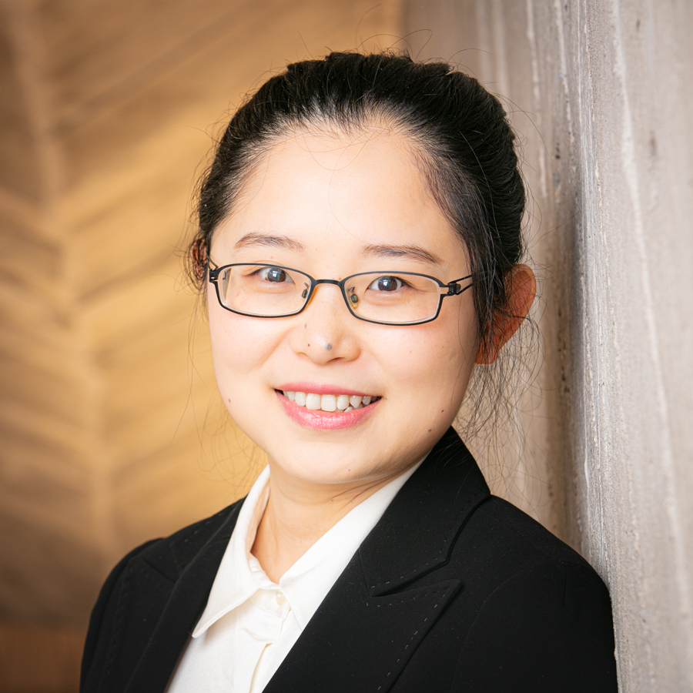
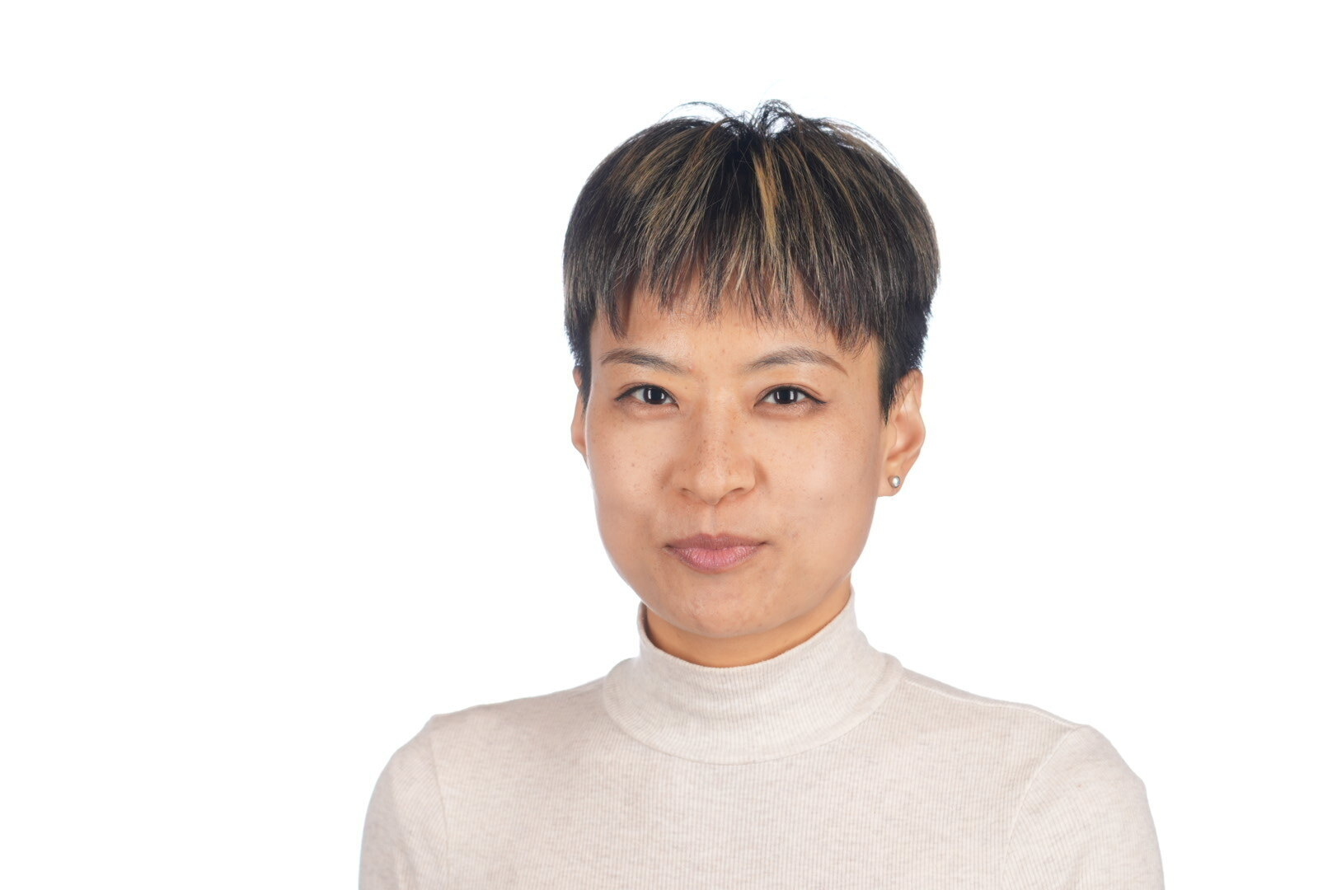

SoCS Committee Members
Minglun Gong
Cathie Hosker
Purvi Patel
Jean Hein
Katie McLean
Sonal Allana
Chandler Gray
Yan Yan
Wenjing Zhang

Slide 3
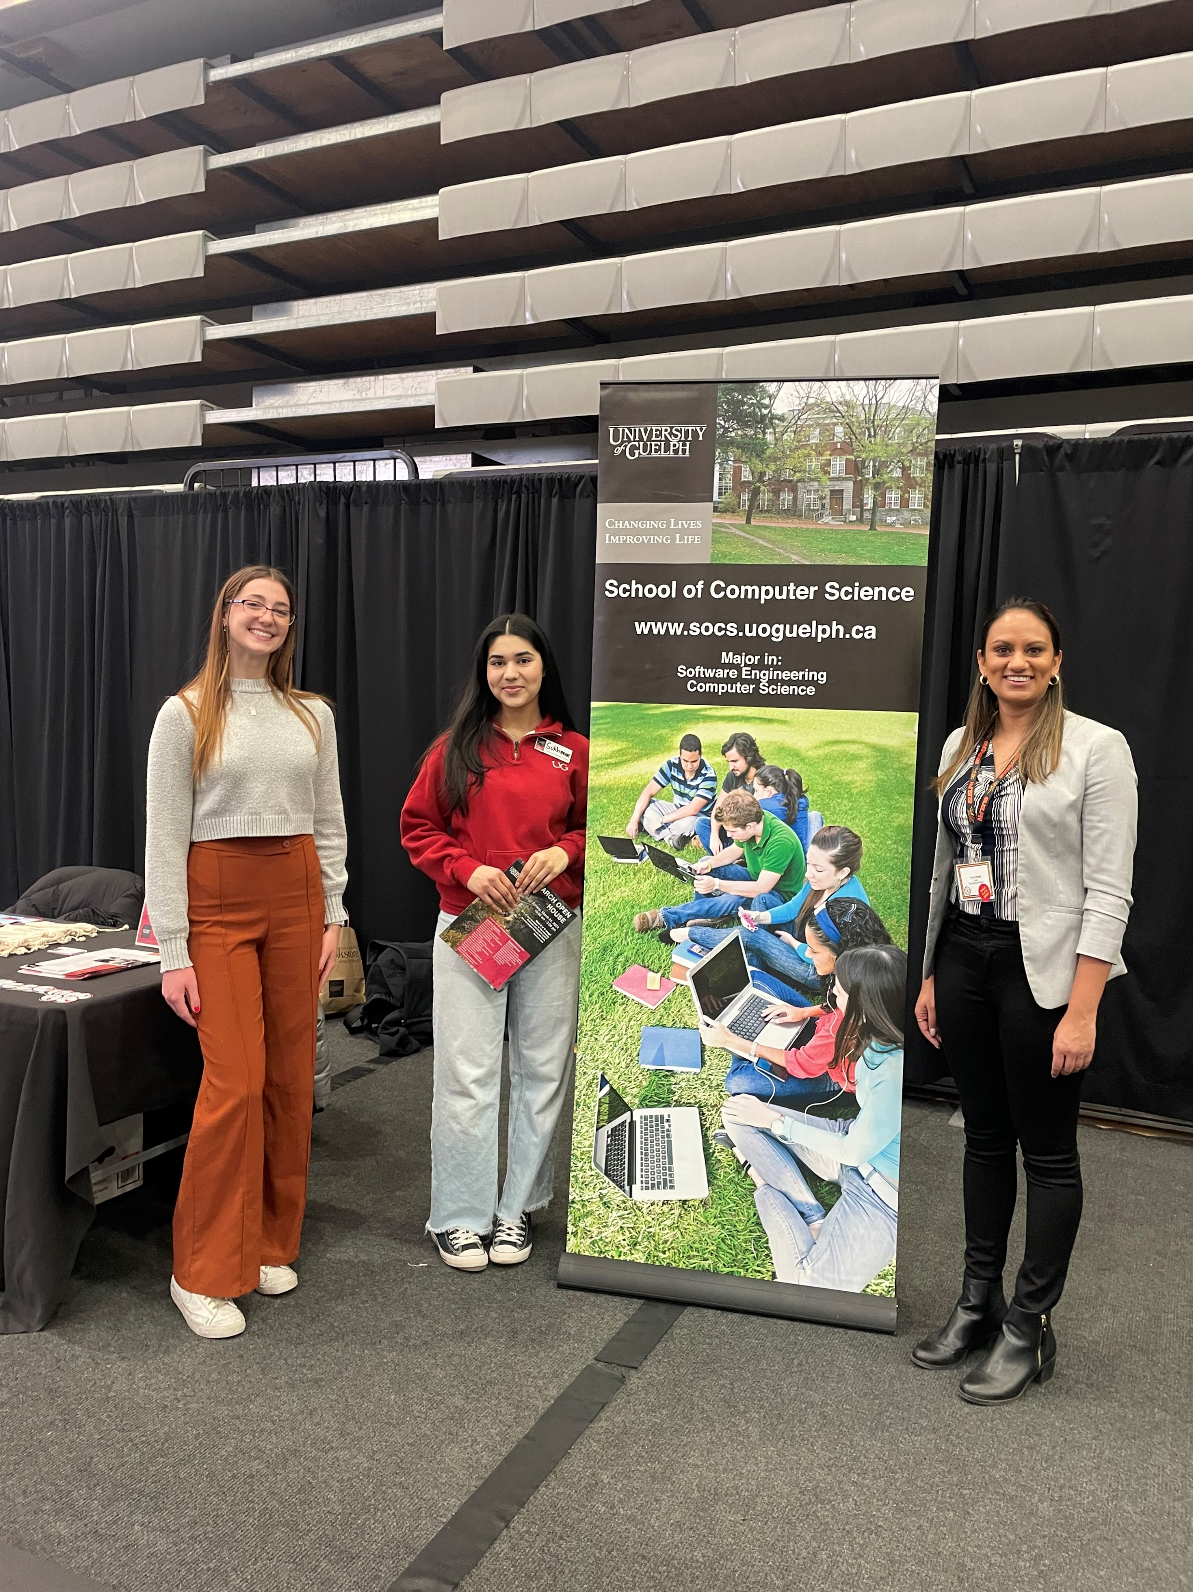
March Open House
Held on Sunday March 24
BCOMP info session attendance was about 232
FAQ’s – primarily on coop and then minors, types of math
courses, admission decision deadlines
Computing Volunteers
Purvi Patel – Recruitment Officer
Sarah Brennan & Greg Klotz – Program Counsellors
Kate McRoberts – Coop Coordinator
Ritu Chaturvedi - Faculty
Bianca Laube Benini & Sukhmanpreet Kaur – Students
Final open house Thurs May 16 – need a sample lecture with faculty member!

