Slide 1
SoCS Graduate Studies Update
Stacey Scott, Associate Director of Grad Studies, SoCS
May 9, 2023

Slide 2
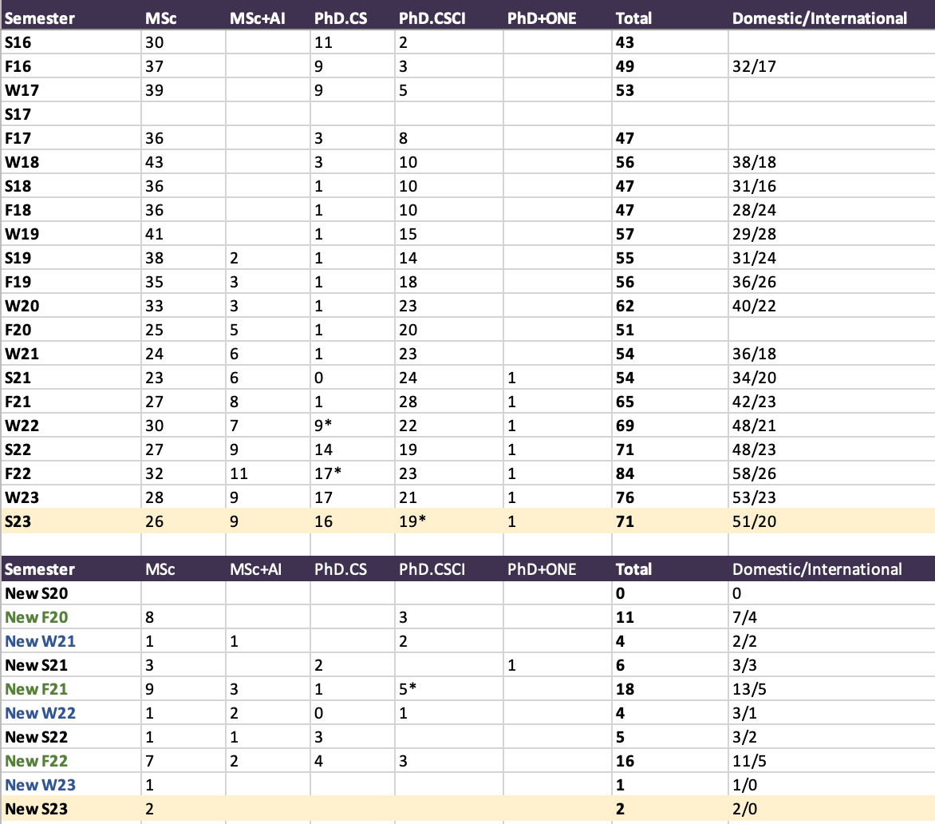
Current Grad Enrollments (excluding MCTI)
Graduate Matters Update May 8, 2023

Slide 3
Discussion on graduate student funding
College *minimums* are currently:
  $16,500/yr for MSc
  $21,500/yr for PhD
  $32,500/yr for PhD students receiving IDTS
Available funding supports (w/ limits per degree):
  2 GTAs/year: $12,250/yr
  Domestic MSc: SoCS Growth fund: $5,000/yr
  Domestic PhD: SoCS Growth fund: $9,000/yr
  Int’l UofG ugrad starting a MSc: IMTS: $10,000/yr
  Int’l PhD (adm. avg > 80%): IDTS: $12,500/year
2022-23 (F22, W23, S23) Graduate Tuition (incl. fees):
$9,053.24 (Domestic MSc)
$8,912.72 (Domestic PhD)
$23,189.27 (Int’l MSc)
$22,357.46 (Int’l PhD)
Take away: Current minimums are VERY LOW given cost of living and tuition. Int’l students are struggling. Many (most?) will immediately look for work outside the university. This takes time away from research, delays thesis work. Please consider a reasonable funding package, if possible, above the minimum.
Graduate Matters Update May 8, 2023

Slide 4
Reminder: Process for arranging defences takes time
PhD defence: process takes 8 weeks (mandated by OGPS procedures)
MSc defence: process takes 4 weeks (mandated by OGPS procedures)
Plan early! Avoid end-of-term crunch if possible!
Graduate Matters Update May 8, 2023

Slide 5
Follow-up on early Council discussion on PhD External Examiner approval process
Clarifications on External Examiner assessment criteria will be made and the External Examiner nomination form will be revised to clarify these criteria
Graduate progress committee will discuss potential streamlining solutions further and bring back to Council
  These may involve reducing the number of required External Examiner nominations, changing when someone gets contacted for their availability, or others
Graduate Matters Update May 8, 2023

Slide 6
Questions?
Graduate Matters Update May 8, 2023

