Slide 1
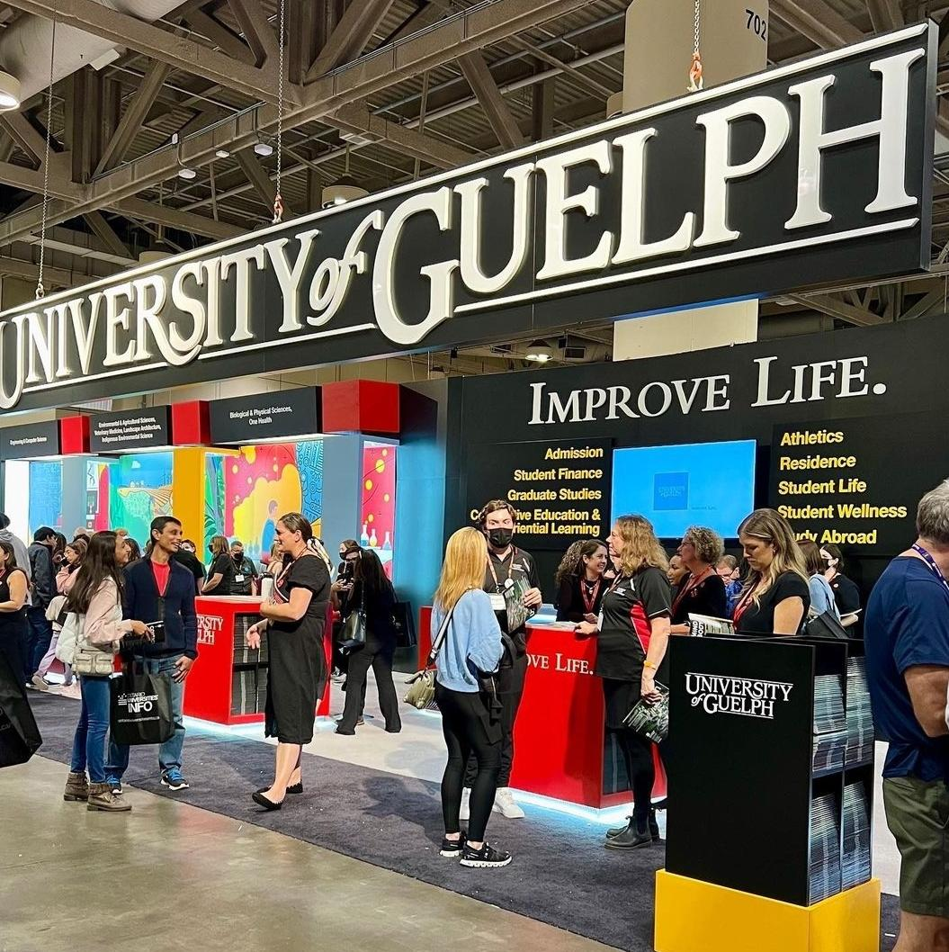
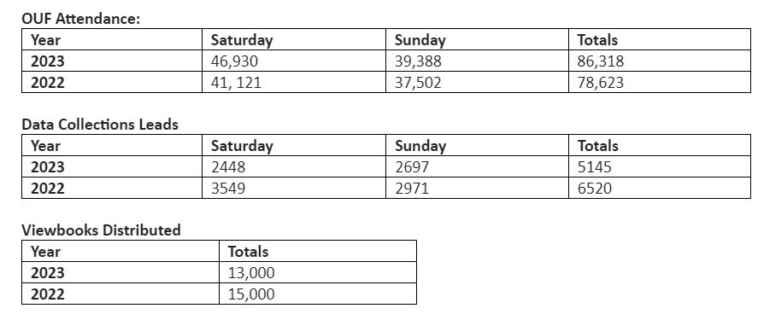

Ontario Universities Fair
Computing Volunteers
Purvi Patel – Recruitment Officer
Rozita Dara - Faculty
Shaiza Hashmi – Student
Maya Saltzman –Student
Thomas Phan - Student
Sara Adi - Student

Slide 2

International STEM webinar
Part of the new ‘Discover Your Degree’ webinar series
77 unique viewers from countries including from UAE, Vietnam, Ghana, Nigeria, USA, Bahamas, Trinidad, Hong Kong, Germany
BCOMP international student – Rashi Mathur
Fall Preview Day
Over 5,000 visitors to campus
Hosted two BCOMP info sessions – attendance total 97
Volunteers – Purvi Patel, Rozita Dara, Ritu Chaturvedi, Laura Gatto, Anne- Marie Zawadzki, Hibah Afroz Uddin
Science & Engineering Sunday
Over 3,000 visitors to campus
Hosted one BCOMP info session – attendance 165
Volunteers – Purvi Patel, Minglun Gong, Laura Gatto, Sarah Brennan, Greg Klotz, Kate McRoberts, Zach Cymbaluk

Slide 3
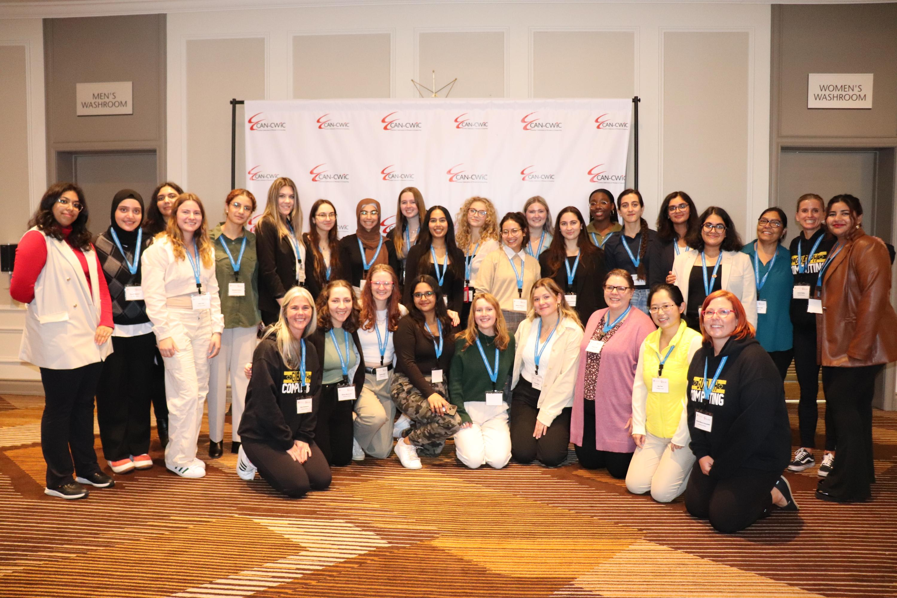
CAN CWiC
October 20-21, 2023
26 SoCS undergraduate and graduate students received financial support to attend the conference (transportation, food, and accommodation):
  19 SoCS students were sponsored by the School and SoCS faculty members
  8 SoCS students were sponsored by Co-operative Education
CAN CWiC program included diverse activities including
  Faculty mentoring and information exchange sessions
  Keynote talks from industry: machine learning, cybersecurity, data science, AI, and more
  Career Fair & Tutorials
  Panels on women in tech leadership
  Research presentations
Sponsors & participants:
​AWS, TD, Google, BlackBerry, CN, BMO, TD, Morgan Stanley, FreshBooks, D2L, CGI, Canada Life, ACM,
University of Toronto, University of Alberta, University of Waterloo, University of Guelph, Université de Montréal, and more

Slide 4
Upcoming Events with SoCS participation
International Virtual Open House – January 20, 2024
Go Code Girl – Grade 7-10. Feb 3, 2024.
International STEM webinar – TBD, Feb 2024
Campus Day – March 2024
Battle STEM – May 9 2024
Spring Academic Open House – May 2024

