Slide 1



GryphHacks
2023
Notes:
Hello everyone! Thank you for your time and kindness and I’m excited to share with you all today the initiative we’re so proud about, GryphHacks 2023! Unfortunately, Rithik and Shaiza aren’t able to make it today, so as the VP Internal, I will be presenting.

Slide 2
About GryphHacks
GryphHacks is the University of Guelph’s Official hackathon, partnered with MLH! We are a student organization that organizes and facilitates an annual innovative event, promoting technological advances through collaboration; from prototypes to potential high-end product concepts!
Our goal is to create an inviting and friendly environment where healthy competition takes place to help foster and nurture our hackers' innovative and entrepreneurial skills! GryphHacks serves to broaden our hackers’ perspectives, and awareness of the various possibilities that are available in this ever-growing field!
Notes:
GryphHacks is Guelph’s official annual hackathon which started off with a success in 2022. A hackathon is a 48-hour marathon for hackers, entrepreneurs, engineers, and innovators from all disciplines who will compete to design and build a prototype to win prizes. We’ve had judges that range from professors to alumni. Our hackathon is an event that allows for students to network with peers and industry professionals, learn practical skills through the form of experiential learning and most of all, have fun!

Slide 3
219 students online
300
students
in-person
Participants from last year
Notes:
Last year we had 219 students participate online, of course due to covid-19.

Slide 4
219 students online
100+
students
online
Participants expected this year
300
students
in-person
Notes:
This year, we’re striving to host it in person with 300 students max, giving us a further 27 percent increase in participants.

Slide 5
219 students online
100+
students
online
300
students
in-person
Notes:
On top of that, we plan on have 100+ students joining us from online, making this one of the largest hybrid events in Guelph.

Slide 6
$
In 2022, we’ve raised
,
0
1
2
3
4
5
6
7
8
9
1
2
0
1
2
3
4
5
6
7
8
9
1
2
0
1
2
3
4
5
6
7
8
9
1
2
0
1
2
3
4
5
6
7
8
9
1
2
0
1
2
3
4
5
6
7
8
9
1
2
Notes:
Last year,

Slide 7
$
0
1
2
3
4
5
6
7
8
9
1
2
0
1
2
3
4
5
6
7
8
9
1
2
0
1
2
3
4
5
6
7
8
9
1
2
0
1
2
3
4
5
6
7
8
9
1
2
0
1
2
3
4
5
6
7
8
9
1
2
In 2022, we’ve raised
,
Notes:
we raised twelve thousand, nine hundred and seventy-two dollars with 16 wonderful sponsors who help us…

Slide 8
















Previous Sponsors
Notes:
host our event and reward hackers for their best prototypes. Sponsors have different tiers allowing for certain privileges for example, access to student resumes and/or other networking opportunities to find prospective Guelph talent.

Slide 9


Officially Partnered with
Major League Hacking
168
Different Universities
28
10
Workshops
Last Year
Different Countries
12 Programs
Interdisciplinary
Notes:
And we’re happy to say we’re officially partnered with Major League Hacking, the official student hackathon league that powers over 200 weekend-long invention competitions that inspire innovation, cultivate communities and teach computer science skills to more than 65,000 students around the world. We’re grateful to reach out to them for sponsorships, resources and more.

Slide 10
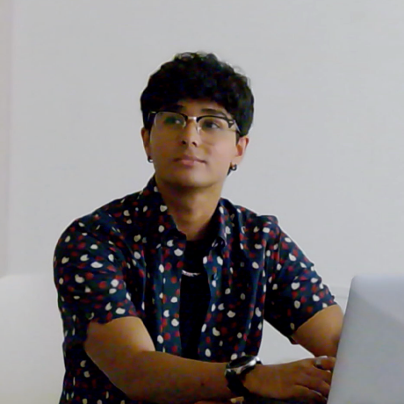
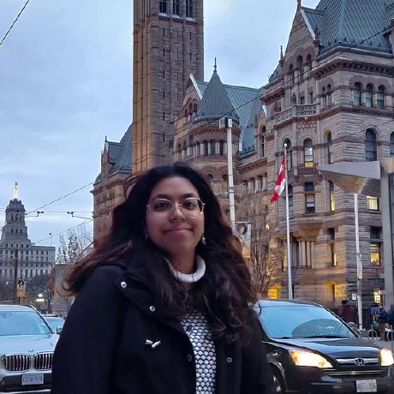
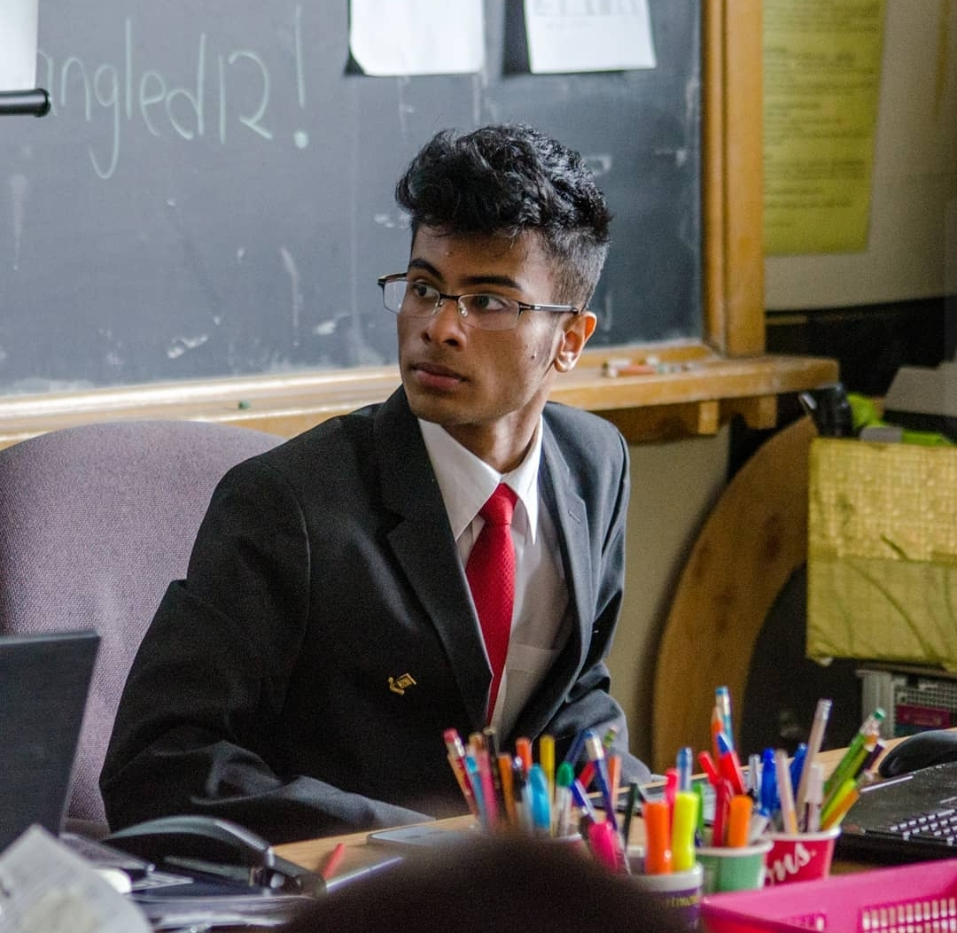
More Hackathon Mania
168
Different Universities
28
10
Workshops
Last Year
12 Programs
Interdisciplinary
Different Countries
Notes:
Some hackathon mania! We have students from 28 different countries, 168 different universities with several dozen high schools, and participants across 12 different programs. We also had 10 workshops last year, some examples being the FAANG alumni panel, an Intro to AR/VR, Kotlin & React workshops, a how to ace your tech interviews workshop and more.

Slide 11

Our Team
Rithik Choudhary
Co-Chair & Founder
Shaiza Hashmi
Co-Chair & Founder
Saqif Abrar
VP Internal &
VP Development
20+ Members
Notes:
This hackathon was founded by our current fearless leaders, Rithik Choudhary and Shaiza Hashmi and of course there is myself who is the VP internal and development for this year.

Slide 12

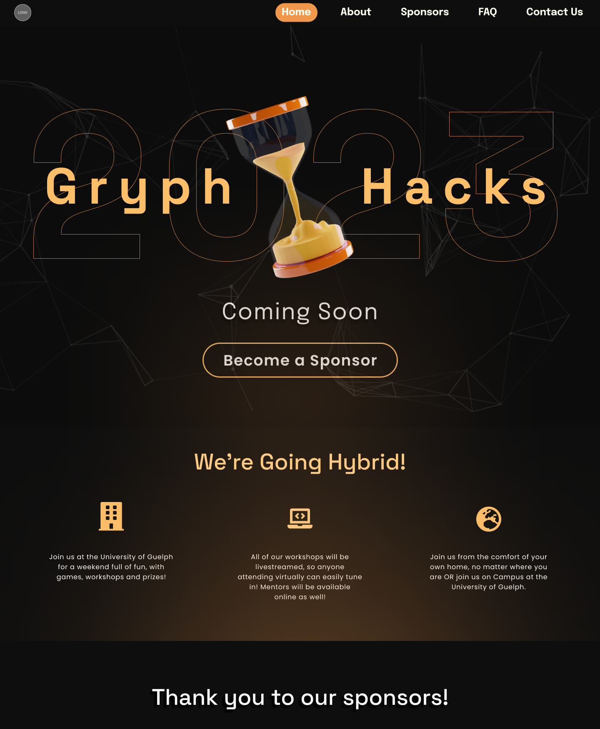
Our Team
20+ Members
Notes:
And of course, there is no ‘I’ in teamwork, so we have over twenty members and we’re still continuously hiring more students for marketing, logistics, events and finance. We love to see the leadership and proactive energy GryphHacks members provide!

Slide 13
Sneak peak on what we’re doing
Notes:
Currently, the development team is hard at work building our main website page for prospective hackers to land on. The marketing team is working on polishing the sponsorship package and ramping up our social media posts. Logistics is working to learn more about different venues, looking at merch pricings, and ensuring we meet security requirements with covid-19 protocols in mind. And finally, the events team is looking to set up a volunteer campaign to get extra manpower for our event!

Slide 14



What we ask from you
Monetary Sponsorships
Marketing & Professor Support
Booking Buildings
Your funding can help us organize the event to create a better experience for students.
We’d love to promote to classes and have access to market to many of the campus buildings.
We need your help booking campus buildings for the venue to show off our Guelph spirit!
Notes:
While we’re still in the planning phase, we still ask for several ways the faculty of SOCS can help with for our initiative. The most impactful being any form of sponsorship that you would be able to provide. Monetary sponsorships are preferred; however, we still highly value the support of the university, so we are open to customizing a sponsorship that better benefits us all in whatever capacity you’re able to assist in. We also have a sponsorship package which outlines the variables perks and tiers available for you to look at and provide to any prospective sponsors and connections and we’re happy to forward that pamphlet to you. It will also shortly be available on our website.
Since the students of the university are our first priority, the ability to communicate to more of them at once is also very valuable so we would greatly appreciate professor support to market our event. This would consist of, at most, one or maybe two posts on courselink/moodle/etc so we can reach our target audience better. We would provide all the materials including any graphic (banner) and blurb for the announcement so it would be as easy as a copy-paste for you. For those of you having in-person classes, then the opportunity to have a quick 5 mins to inform your classes of the academic and career benefits of our event would also be greatly valued.
Lastly, we are still in the midst of securing campus space as our venue to hold our in-person hackers. We know this is a long and often pricey matter, especially since we'd be booking it for 2.5 days (48hr hackathon + setup/takedown). Any support to speed up the processing of booking a venue or minimizing the costs would be immensely appreciated as this event promotes our university and its programs.

Slide 15
You can contact us at
. admin@gryphhacks.com

Slide 16
Thank You

