Slide 1
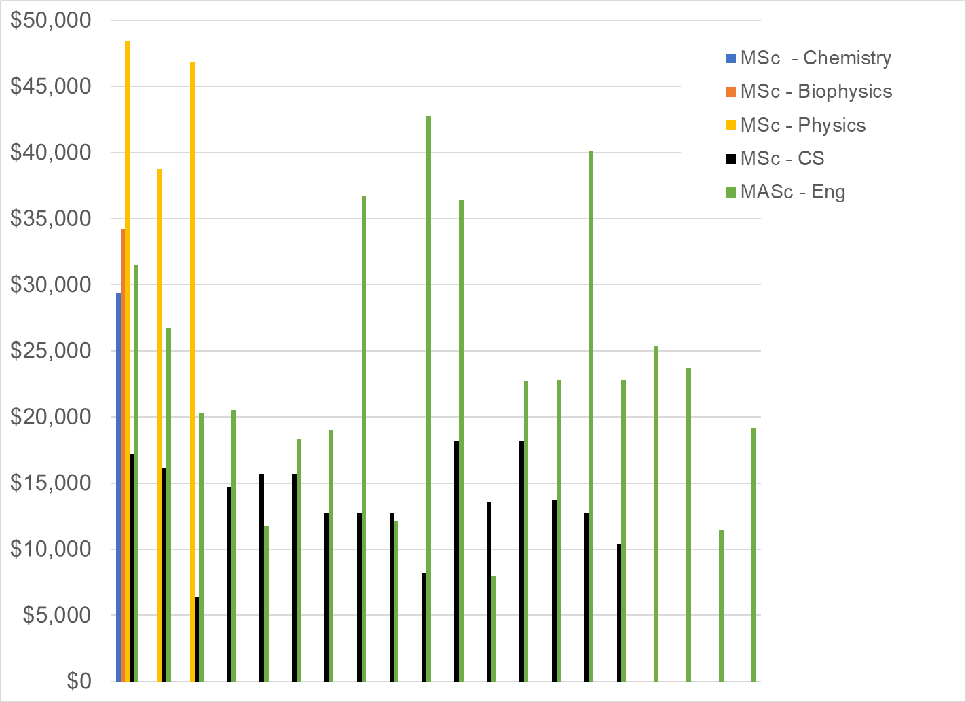
CEPS International Masters Students (Total Funding Provided)

Slide 2
CEPS International Masters Students (Total Funding Provided)
Tuition = $23,000

Slide 3
CEPS International Masters Students (Total Funding Provided)
Tuition+cost of living = $36,000
Tuition = $23,000

Slide 4
CEPS International Masters Students (Total Funding Provided)
Tuition+cost of living = $36,000
Tuition = $23,000
Proposed Minimum Stipend = $16,500

Slide 5
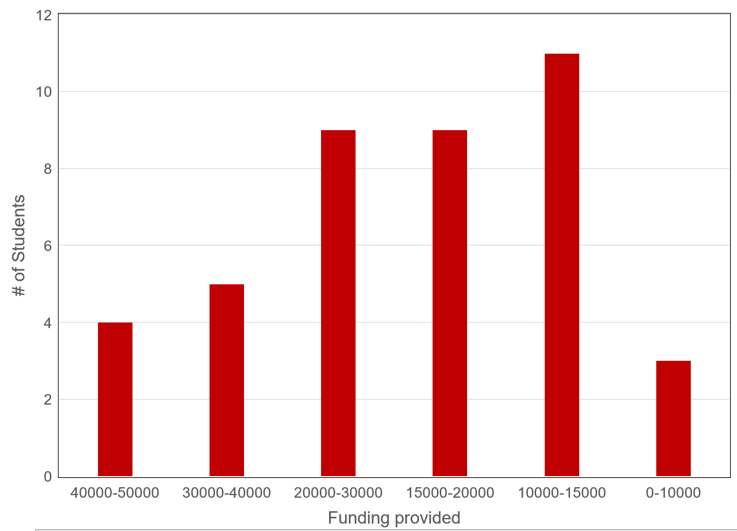
CEPS International Masters Students (Total Funding Provided)

