Slide 1
Update on Outreach Activities
Stacey Scott
Chair, SoCS Outreach Committee
Assistant Director, SoCS
SoCS Council Meeting, February 16, 2021

Slide 2

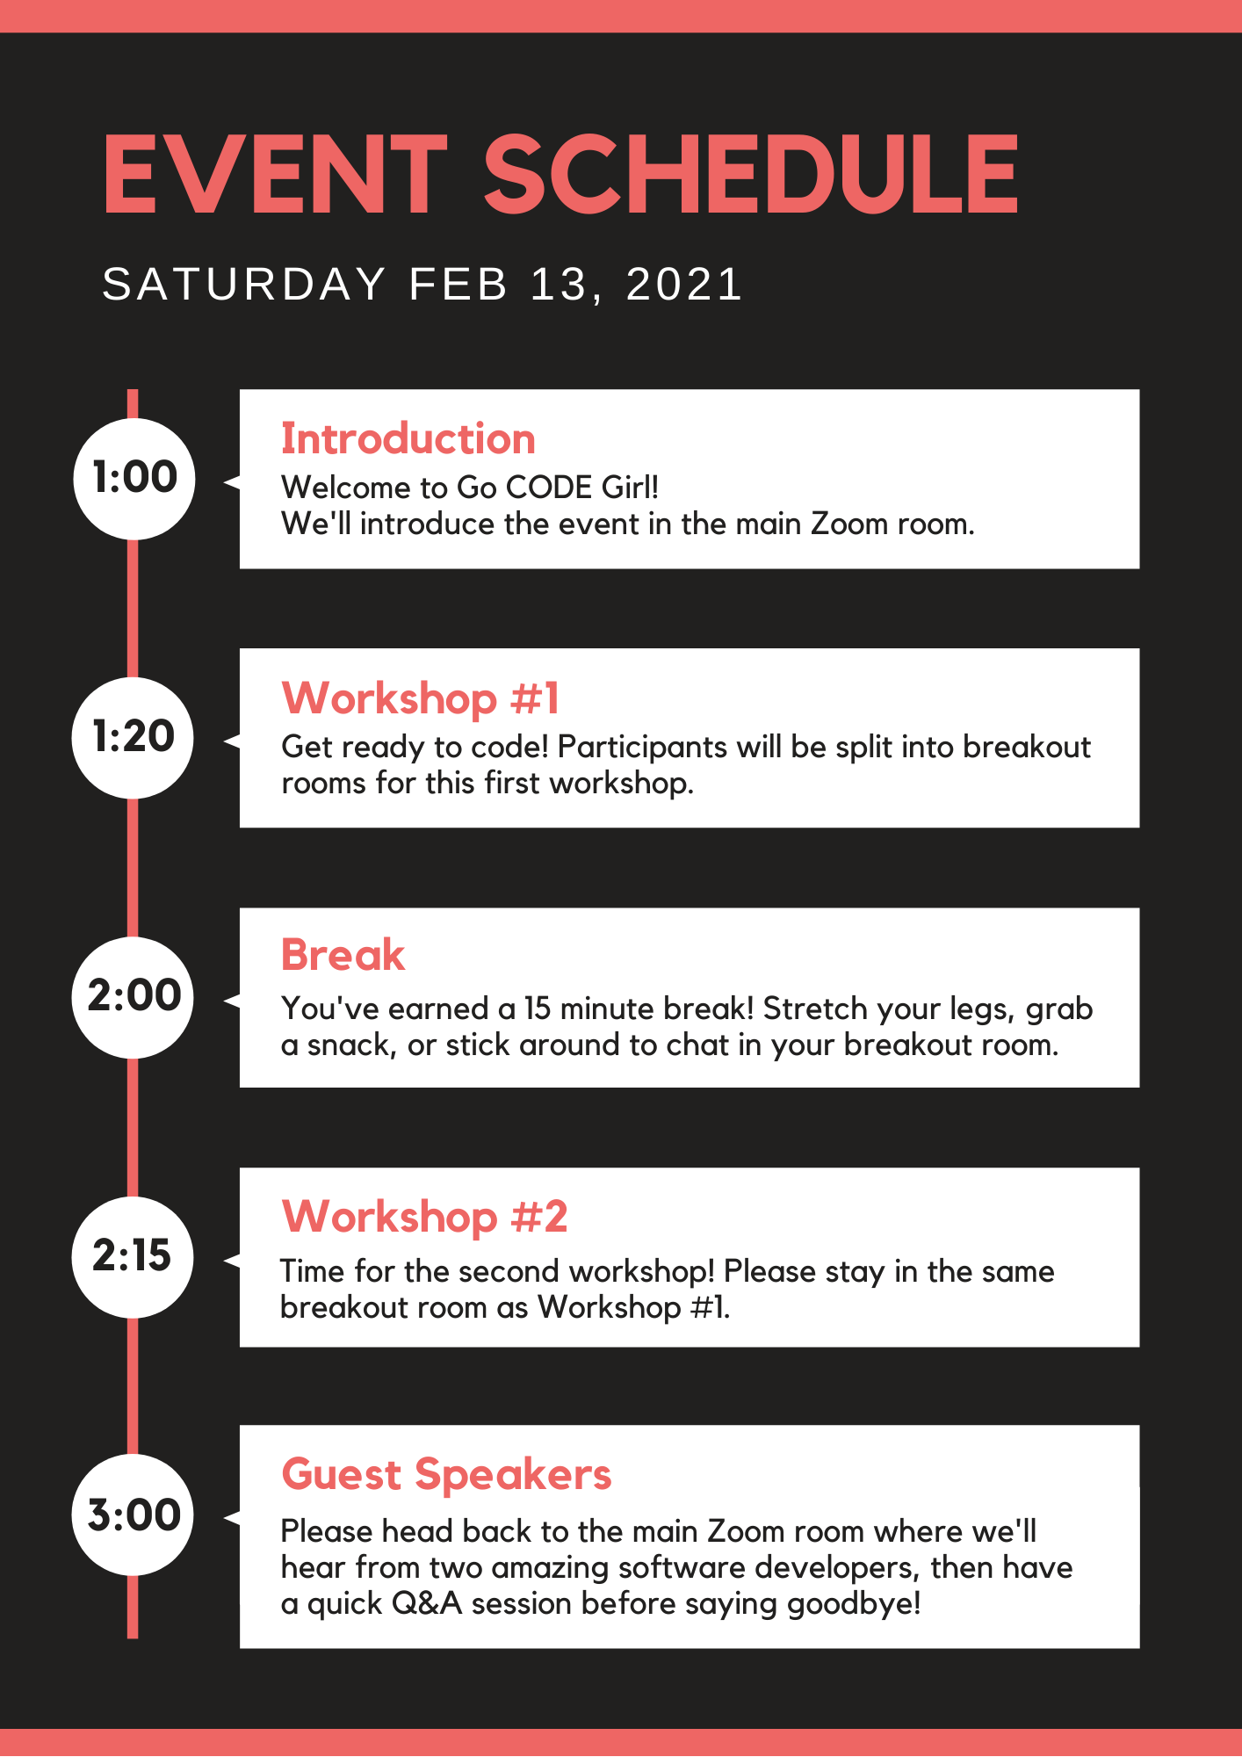
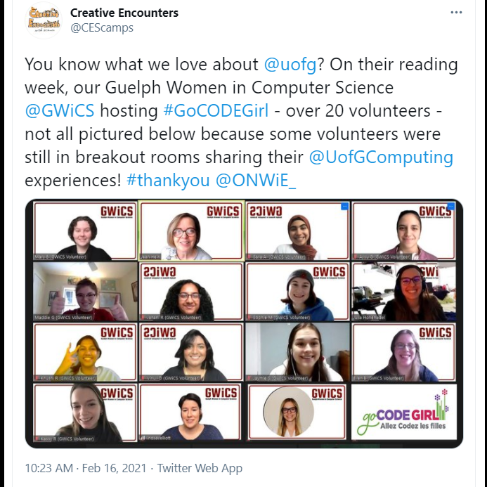
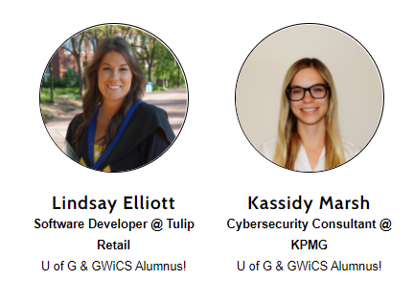
Go CODE Girl – February 13th
  39 Participants
  21 GWiCS volunteers running workshops & managing event
  +3 SoCS, CEPS staff/faculty supporting event
    Huge thanks to Jean Hein!
  2 guest speakers:
Notes:
Workshops on Digital Detectives & Build Your Own Website

Slide 3
Outreach / Awards News
AA&AD (Melissa Woo and Dan Penfold) planning virtual SoCS Alumni Week event
  Thursday, June 25th
  Tim Bray, BSc (Math & CS) 1981 alum guest speaker and alumni awardee
  Other alumni will be honoured also
  Will be a preview to SoCS’s 50th anniversary celebrations, which will start in the Fall
In recognition of SoCS 50th anniversary, AA&D and SoCS will launch an ambitious campaign to raise $50K in student scholarships (ugrad and grad) over the next year
Notes:
Volunteers will be contacted very shortly.
If anyone wants to volunteer on the chat side of things, please let me know.

