Slide 1

Career Services for
Computer Science Students
Amoy Marshall Green, Career Advisor
CEPS Portfolio

Slide 2
About Me
Amoy Marshall Green
Career Advisor – CEPS since November 2021
Been in career development since 2004, including
  Employment Ontario / Lutherwood
  Conestoga College
Alumna of UoG – graduated 2018
MSc Family Relations & Human Development
Dedicated my life to support others in their career growth and development

Slide 3
Objectives
The goals of the presentation are to:
Introduce the Challenge Mindset
Share with you the Career Services available to students
Suggest how you can help

Slide 4

What is the
Challenge Mindset
The Challenge mindset is an approach to career exploration focused on finding challenges to tackle instead of job titles to fit into.
This interactive experience is designed to help students find a career path based on exciting, real-world challenges that go beyond job titles
https://www.uwrf.edu/AcademicSuccess/PreMajorExploratory/SparkPath.cfm#:~:text=The%20Challenge%20mindset%20is%20an,that%20go%20beyond%20job%20titles.

Slide 5

Challenges
Companies
The Challenge Mindset
Jobs
Education Programs
Employability Needs
Source: mysparkpath.com
Notes:
How you can move forward from where you are now:
First… you pick the challenges you want to work on.
Second… you find companies that are working on those challenges.
Third….you find people working at those companies and the different jobs they do.
Fourth…. you look at the education programs they studied.
Fifth… you identify employability needs that would help prepare you for the work.
This is a different model of looking at careers, but one that is much more appropriate for the future of work.
Transition: Let’s find out which challenges you are interested in.

Slide 6


Or
Notes:
Okay … Are you ready…. let’s play a game… Challenge Card Face Off!
Can you tell me which one of these challenges is more important to you?
And the winner is …. XXXX
Challenge face off round one complete… on to round two
While playing the game discuss…
A provoking thought to share with your clients is that if you don’t choose the challenges you want to work on, someone else will choose for them.
This is what happens, clients drift from thing to thing without much thought or intention.
It is hard not knowing why you go to work, and there is power in knowing, and you have a chance to unlock that for them by teaching them the challenge mindset.
Why do clients choose the cards they choose; lived experiences, values, interest, abilities, family's environment, their stories. (who they are)
What is lovely is that people see what they want or need to see in the cards, the words and images bring different meaning to different people (what inspires, what aspires)

Slide 7


Or
Notes:
Have a discussion about why people choose the cards they do ….. What comes up for them…
Why do students choose the cards they choose; lived experiences, values, interest, abilities family's environment they stories.
What is lovely is that people see what they want or need to see in the cards, the words and images bring different meaning to different people
A provoking thought to share with your students is that if you don’t choose the challenges you want to work on, someone else will choose for them.
This is an excellent way to introduce the challenge mindset to clients. If you would like to use this method please feel free…. You can even use these slides
So now we have discovered an activity you can use in a workshop called the challenge face off
We have discovered the power of why clients choose their challenges
Now we have to round up – the finals
Round 1 the winner was…
Round 2 the winner was…
Round 3 would you rather …. Or ….
And the winner is End extreme poverty. Thank you for partiticpating.

Slide 8
Career Services for SoCS Students
INDIVIDUAL (virtual/in-person both co-op and non-co-op)
Career Advising appointments on www.experienceguelph.ca on topics like
Career Planning
Career Assessment - Challenge Card Assessment / MBTI
Cover Letter Review
Further Education
Graduate/Professional School Interview or Application Review
Interview Preparation
Job Search Advising
LinkedIn Review
Resume/CV Review
Teacher Education Interview or Application Review

Slide 9
Career Services for SoCS Students
INDIVIDUAL (virtual/in-person)
Career Advising from the Experiential Learning Hub course on CourseLink
  https://www.recruitguelph.ca/cecs/news/2021/02/new-course-career-advising-experiential-learning-hub

Slide 10
Career Services for SoCS Students
Upcoming Events
Rakuten Kobo – Virtual Info Session on Oct 4th at 5:30 PM
LinkedIn Workshop & Headshots
Technical Resume Writing
Developing Your Interviewing Skills
Mentorship in Career Development
Job Searching Skills
Open to your suggestions…

Slide 11
Career Services for SoCS Students
GROUP (virtually/in-person)
Targeted events/workshops on www.experienceguelph.ca
Employer Information Sessions – Tech Meet & Greet
Employer Recruitment - Microsoft,
Alumni Panel Discussions – Career Night, etc.
Topical Workshops – Resume Tips, Tech Interviews, Job searching, etc.
P4E Career Fairs – Collaboration with University of Waterloo, Wilfrid Laurier University and Conestoga College
Class session – upon invitation from professor

Slide 12
How You can Help
Now that you know the Career Services available:
Share the information with you students and colleagues
Refer them for support
Invite your Career Advisor to share with your class
    About the Career Services offered – approx. 15-20 minutes
    About a specific topic of interest or gap – approx. 45 minutes
Volunteer ideas of workshops that will fill students’ knowledge/skills/attitude gap(s)
Encourage students to attend workshops and event put on by the Experiential Learning Hub of which Career Services is a part

Slide 13
Conclusion
Eager to collaborate with champions
Look out for emails and events
Connect with me
Help me to help you and your students – realize that it’s not too early to start sharpening their career development skills. E.g. – learning how to capture their projects on their resume or in portfolios/LinkedIn.
Together, we can help students make the connection between their learning/knowledge and the real world so they can have a smooth transition into the labour market.

Slide 14
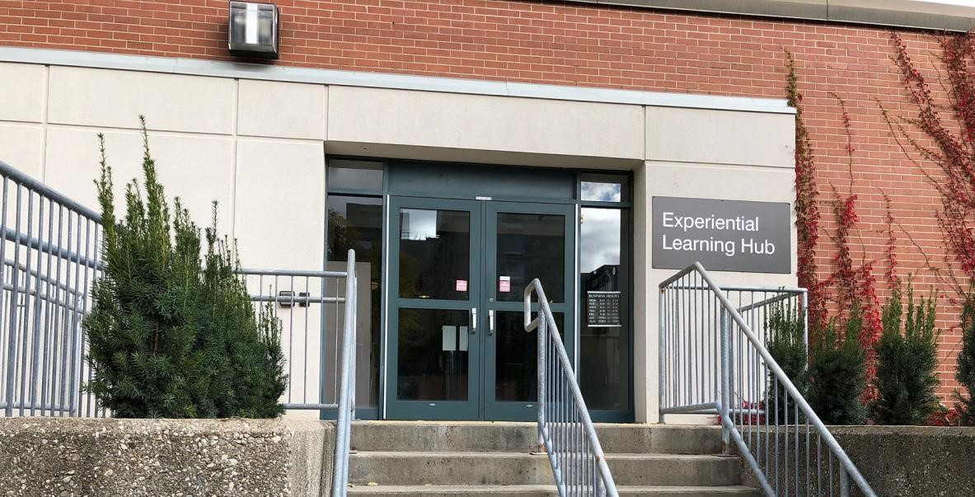

Thank you for your time, attention and support.
If you have any questions, please contact me
Amoy Marshall Green
amoy@uoguelph.ca
Located behind Rozanski – Trent Lane, Bldg. 54

