Slide 1
You create.
We amplify your impact

Slide 2

Our Evolving History of Support
+30 yrs
Technology Transfer Services
+8 yrs
Industry Liaison Support
+1 yr
New Venture Creation & Knowledge Mobilization
Notes:
https://www.uoguelph.ca/research/innovation

Slide 3






Industry Liaison
Building partnerships with industry
Knowledge Mobilization
Getting new solutions into the hands of end users
Research
Impact
Technology Transfer
Licensing technology for new products to industry
New Venture Creation
Connecting and enabling entrepreneurs
Our Office Supports Researchers

Slide 4

Capacity Building Services
Advantage Workshops
Entrepreneurship
Innovation Immersion Placements
Research Innovation Grants
Knowledge Mobilization

Slide 5
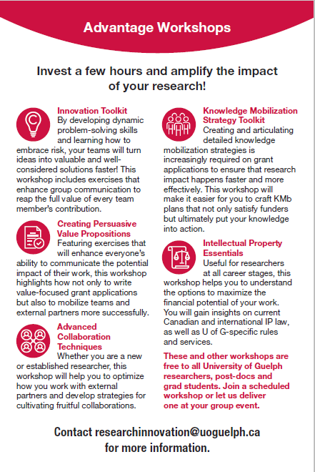
Advantage Workshops
For Researchers and their teams who want to
Win more grants
Develop long term collaborations
Mobilize teams more easily
Improve team dynamics
Generate more good ideas
Commercialize more often
Notes:
https://www.uoguelph.ca/research/innovation/food-thought-grants

Slide 6

Entrepreneurship skills encourage value focused Research choices

Slide 7








“Accelerator Guelph helped bridge the gap between science and business in a way that was accessible, flexible and relevant to our expertise.”
Notes:
https://www.uoguelph.ca/research/innovation/commercialize/accelerator-guelph
Use this slide to identify our success in creating spin outs who will impact the economy

Slide 8
Innovation Grants
Commercialization Grants: provide funds to validate, test and launch new commercial products developed in research into market
  Gryphon’s LAAIR
  Barrett Grants
  Food from Thought Commercialization Grants
  For more information
    David Hobson
    dhobson@uoguleph.ca
    Ext. 58859
Notes:
https://www.uoguelph.ca/research/innovation/commercialize/research-innovation-grants

Slide 9
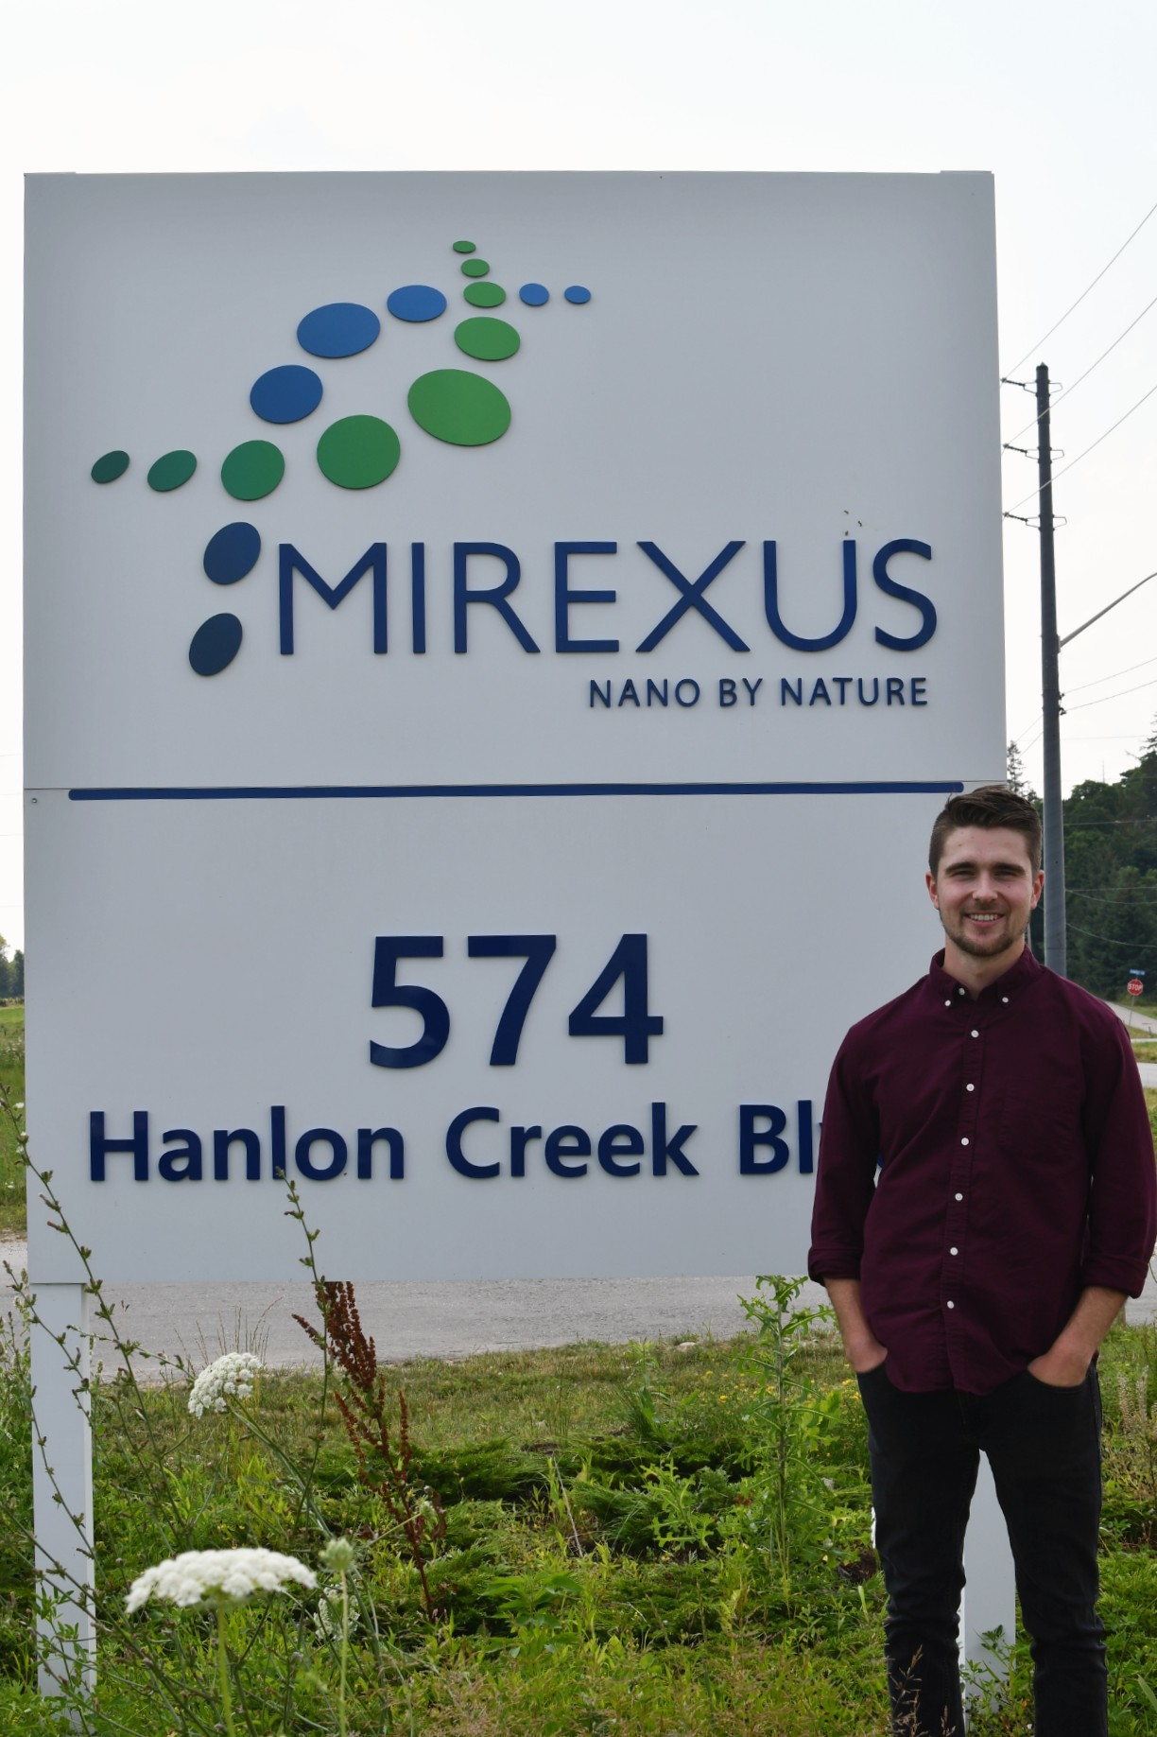
Innovation Immersion Placements
We embed researchers and grad students in dynamic entrepreneurial environments to acquire tools and habits that will invigorate on campus teams
2 Opportunities for May
Notes:
https://www.uoguelph.ca/research/alerts/content/innovation-immersion-placements-2020-open-applications

Slide 10

Knowledge Mobilization
Planning: Knowledge transfer for research grants and proposals
Policy Fellowships: facilitate the exchange of knowledge with outside world
Clear language products: to increase the impact and uptake of UoG research
  For more information:
    Elizabeth Shantz
    eshan@uoguelph.ca
    Ext. 53093
Notes:
https://www.uoguelph.ca/research/innovation/create/knowledge-mobilization
We need knowledge mobilization because there is a gap in communication between knowledge and practice; evidence published in scientific journals simply isn’t getting used by decision-makers. It has been estimated that it can take 17 years for evidence to reach clinicians in the medical field, and up to 30 for research to reach the general public. Other studies estimate that only 45% of patients are not receiving care that is recommended by science; cancer outcomes, for example, could be improved by 30% by optimum application of what is currently known.

Slide 11


Slide 12
Appendix
About the Research Innovation Office

Slide 13

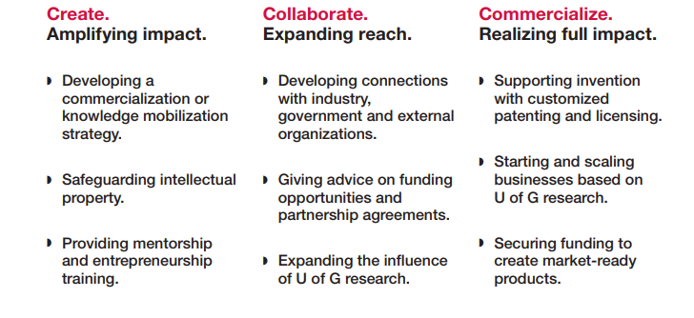
Enable Impact
Develop Partnerships
Realize Benefit

Slide 14

190 inventions reported
60 IL projects brokered worth more than
$8 million over past 2 years
20 active startups with $46 million in private capital raised since 2007
6 issued patents
30 new licenses and 274 active agreements
$2.2 million
license income
$148 million
total sponsored research
Notes:
Current Data from 2015-2017 - Numbers to be updated!

Slide 15


Industry Liaison
Our Industry Liaison team:
Helps researchers to form strategic partnerships with industry
Supplies support while navigating non-disclosure agreements, IP ownership discussions, etc…
Advises researchers on grants and grant applications

Slide 16

Technology Transfer
Our commercialization specialists help faculty to protect, manage and benefit from their intellectual property
  Invention disclosure
  Patents
  Marketing plans to support licensing
  Negotiation Support
  License Agreements

Slide 17
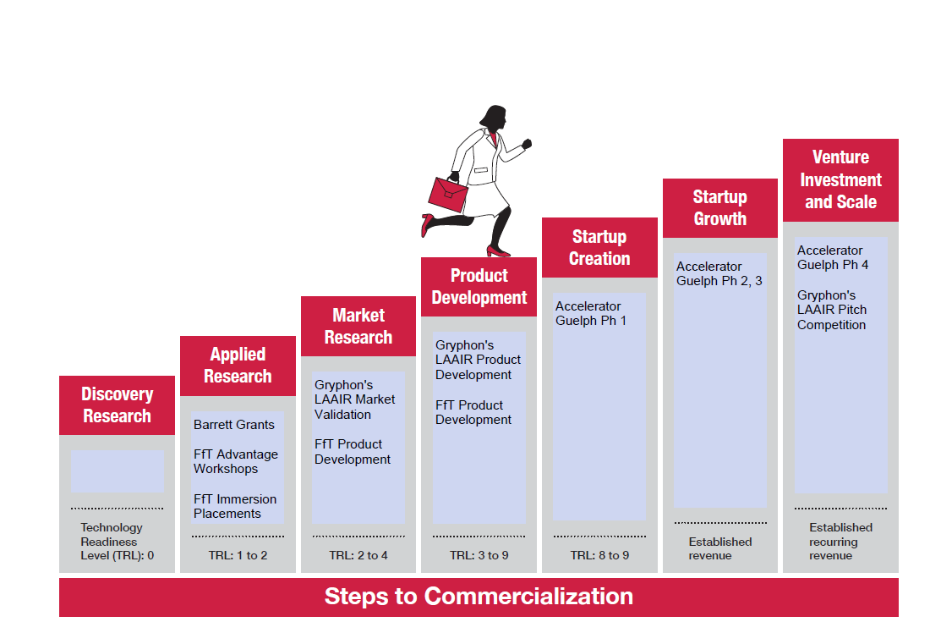
New Venture Creation
Offers research teams support at every step of commercialization:
Advice, consultation and mentorship
Research Innovation Grants to de-risk and prototype technology
Accelerator Guelph: an entrepreneurship and incubation program based on the award winning Waterloo Accelerator Centre program

