Slide 1
MCTI 2019

Slide 2
Numbers
Marketing activities started in late May 2019
6 Domestic and 8 International students registered
Lowest admission average:75%; highest admission average: 89%
Total of CAD 1.8M in-kind contributions from MacAfee and Cisco (over three years)
Total of CAD 35K industry scholarship (5k each) to 7 students
Total of CAD 46K inaugural grant from university to 10 students
Estimated cost of program (as of 11-Nov-2019): CAD 87,645K
Estimated income to the college:
  (6*5,500) + (8*22,500) = CAD 213K
Estimated profit in 2019 (unrealized): CAD 125,355

Slide 3
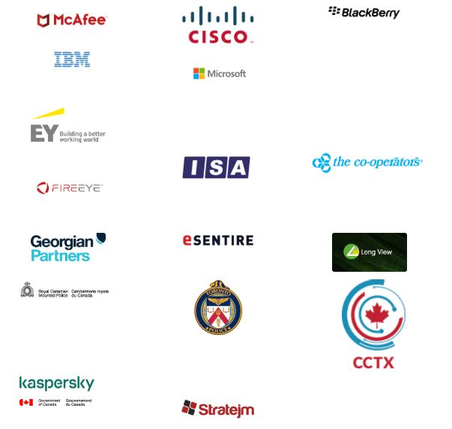
Industry Aadvisory Board

Slide 4
Challenges
Many issues that were not predicted, so a bit bumpy year ☺!
Lab space is not suitable for teaching!
1 full-time admin is required to support a bigger cohort
  Student admission and registration
  Scholarships administration
  Guest speakers arrangements (on average one speaker every two weeks)
  Admin support for advisory board meetings (twice a year)
  Admin support for the project identification workshop (in Feb)
  Admin support throughout student projects (May-Aug) such as contracts, NDAs, etc.
  Admin support for the project presentation event (late Aug)!
Any suggestions?

Slide 5
Let’s Work Together?
Students projects: by default are taken with the industry but open to faculty members too!
In 2019, it is agreed to pay 1,000 for each student project to the faculty research account
Please let us know if you are interested in supervising MCTI students
Please let us know if you know companies who might be interested in offering summer projects to MCTI students
MCTI is a SoCS program, so all faculty/staff will be benefited from the program.

Slide 6
Thanks!

